Slide 1
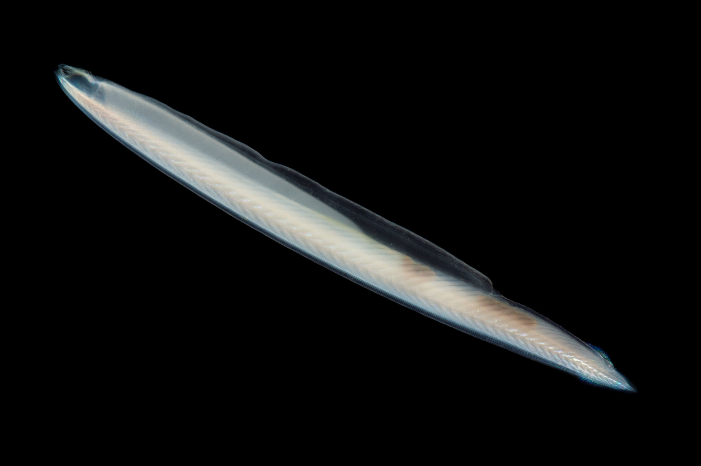
Amphioxus (Lancelet)

Slide 2
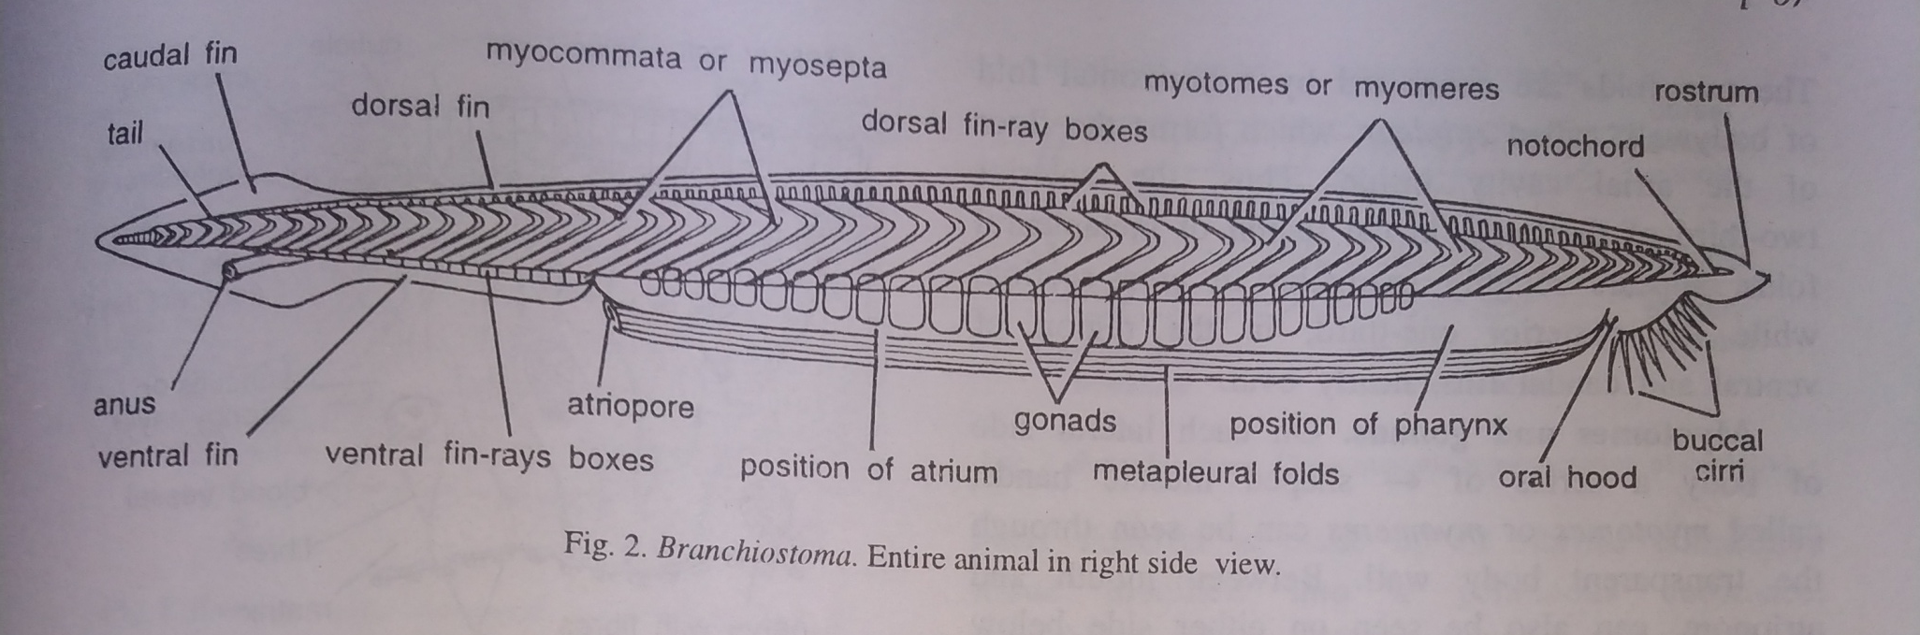
Cephalochordata
Cephalo-head, Chordata- Notochord
Notochord extends into the head region
Phylum- Chordata
Sub-Phylum – Cephalochordata
Class- Leptocardii
Genus- Branchiostoma
Classification
Sub-Phylum – Cephalochordata
Class- Leptocardii
First described by German scientist Pallas in 1778 but he described it as a Mollusca.
Italian scientist Costa (1834) first described it as a chordate.
Genus- Branchiostoma
Genus- Asymmetron
(has unpaired gonads and asymmetrical metapleural folds)

Slide 3
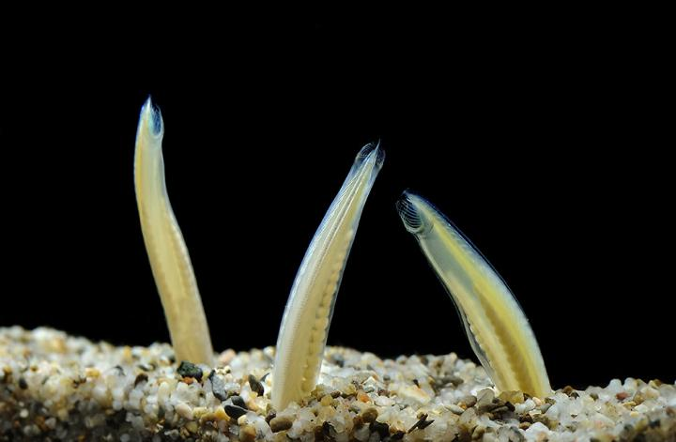
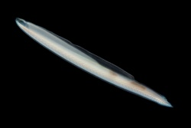
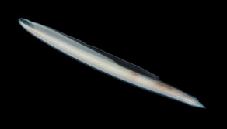
Burrowing Habit
Head Region

Slide 4

External Features (Morphology)

Slide 5
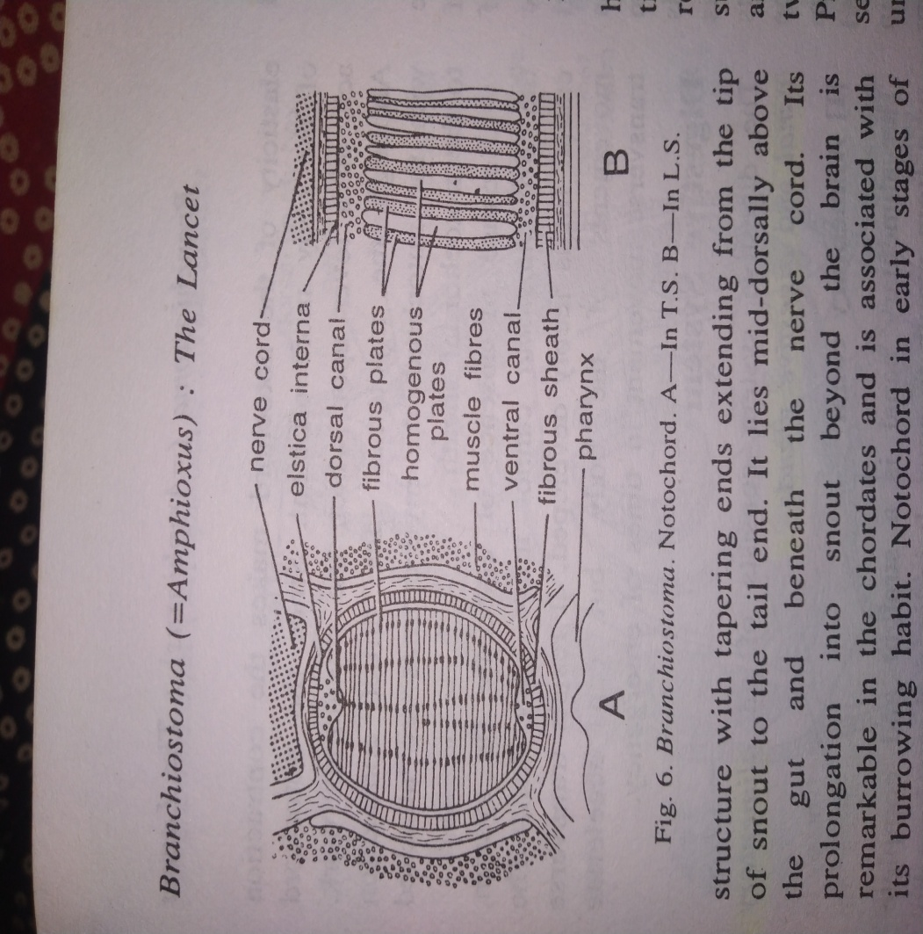
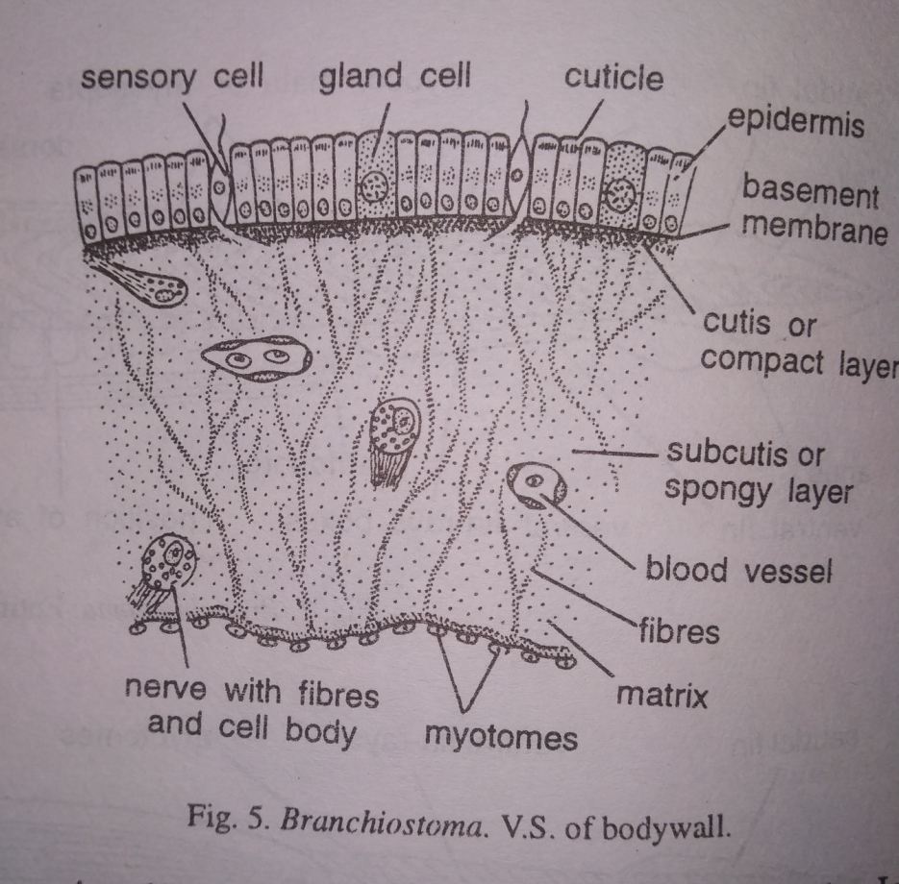
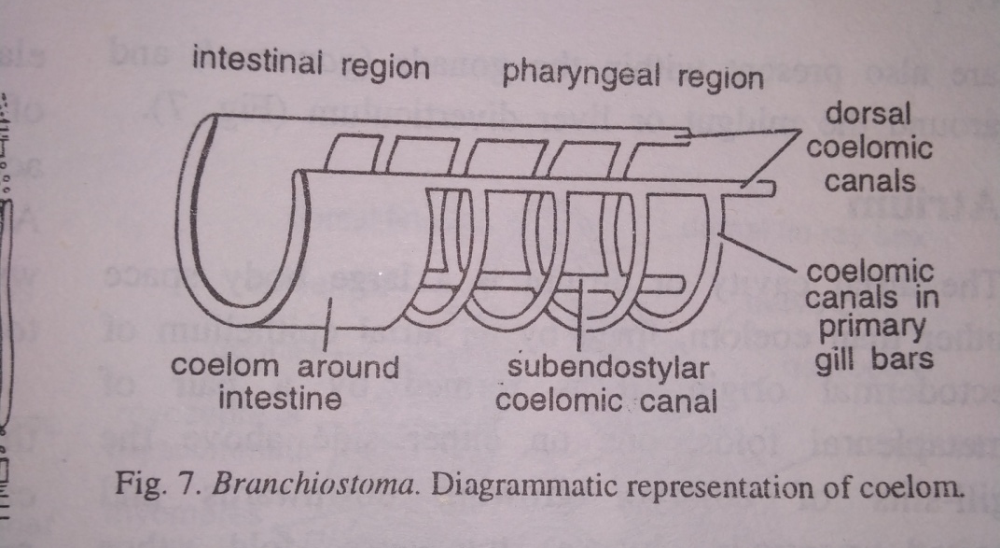
Body Wall
Notochord
Large vacuolated cells during developmental stages
Alternate rigid homogeneous gelatinous plates in adults
Delicate Skin (exterior most)
Well developed muscles
Parietal Peritoneum
Enterocoelom (body cavity)

Slide 6
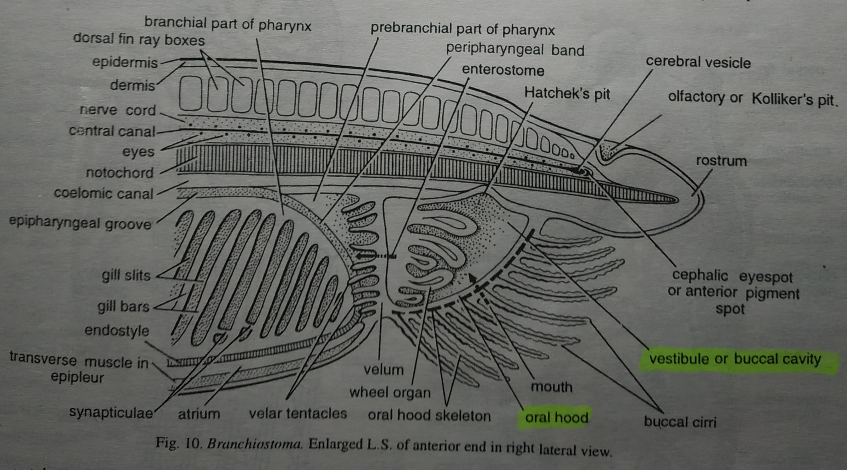
Digestive System
Alimentary Canal – Mouth, Oral Hood, Velum and Enterostome, Pharynx, Oesophagus,
Intestine, Anus
Digestive Glands – Midgut Diverticulum (liver)
Physiology of Digestion

Slide 7
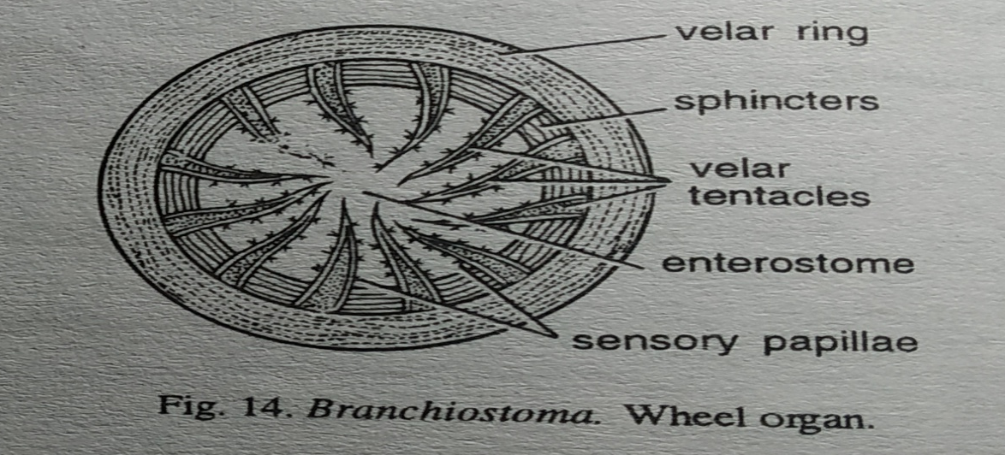

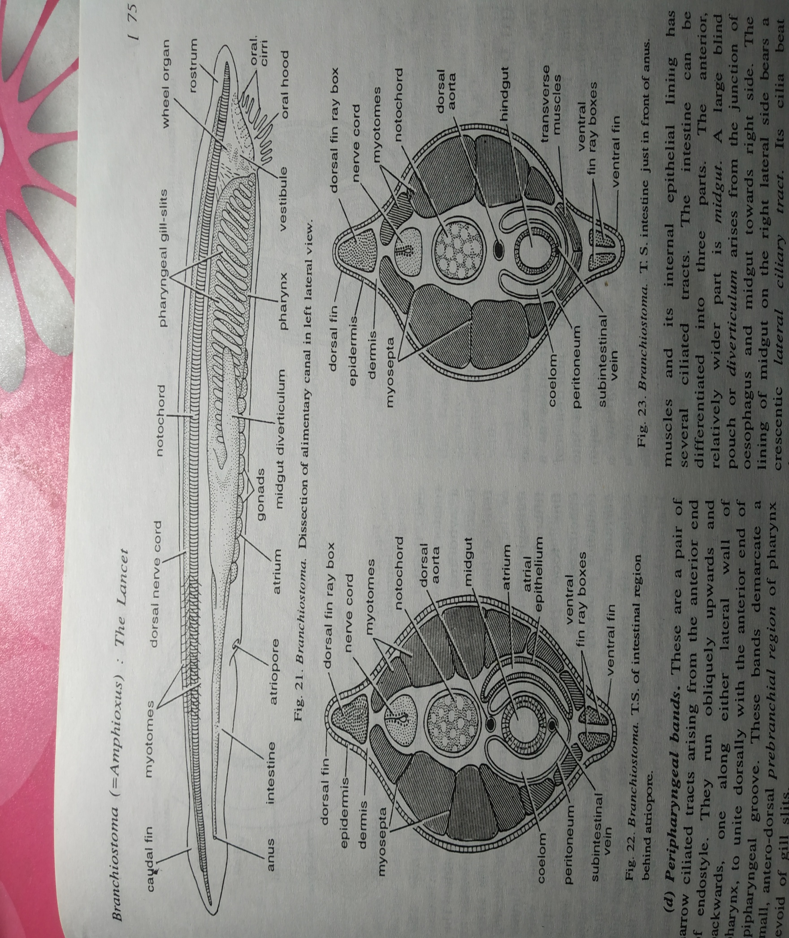


Slide 8
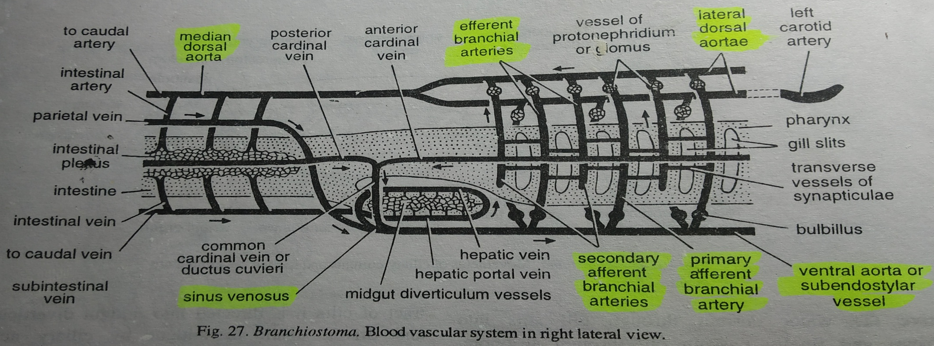
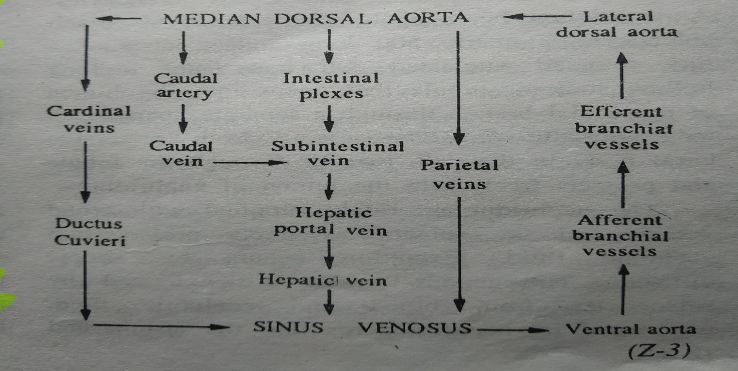
Circulatory System
Flow of Blood in the body

Slide 9
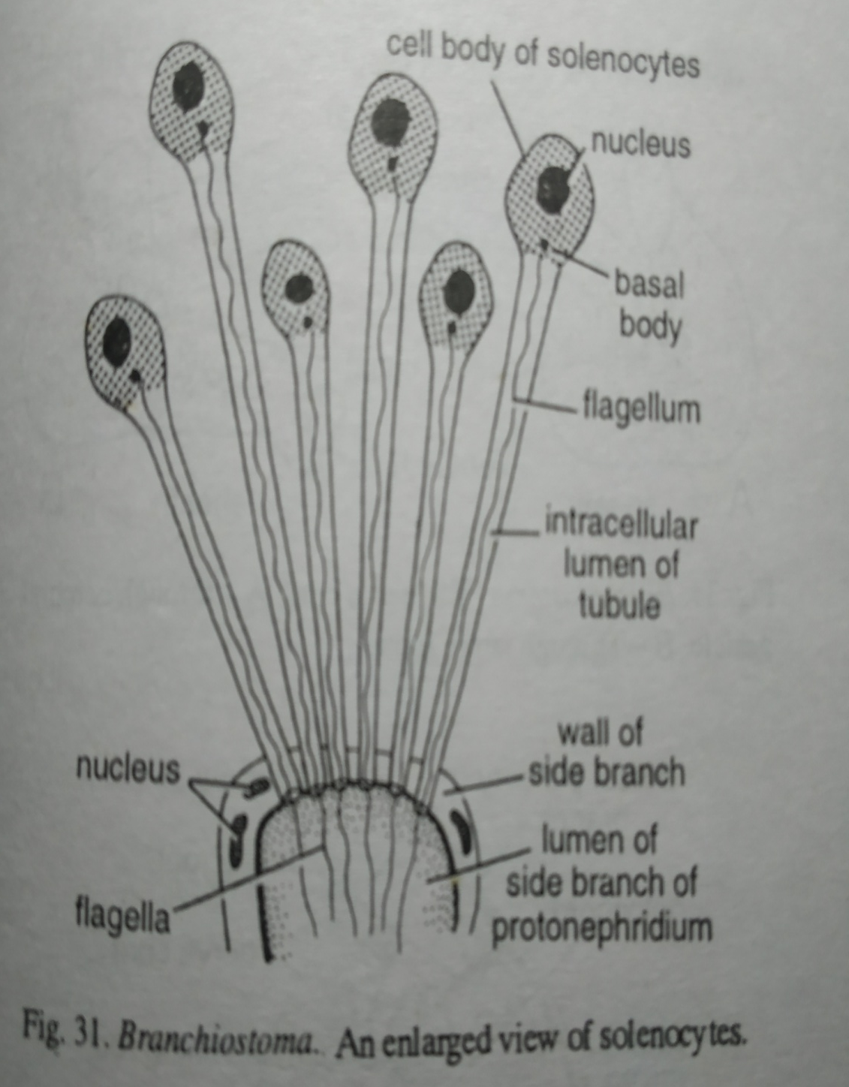
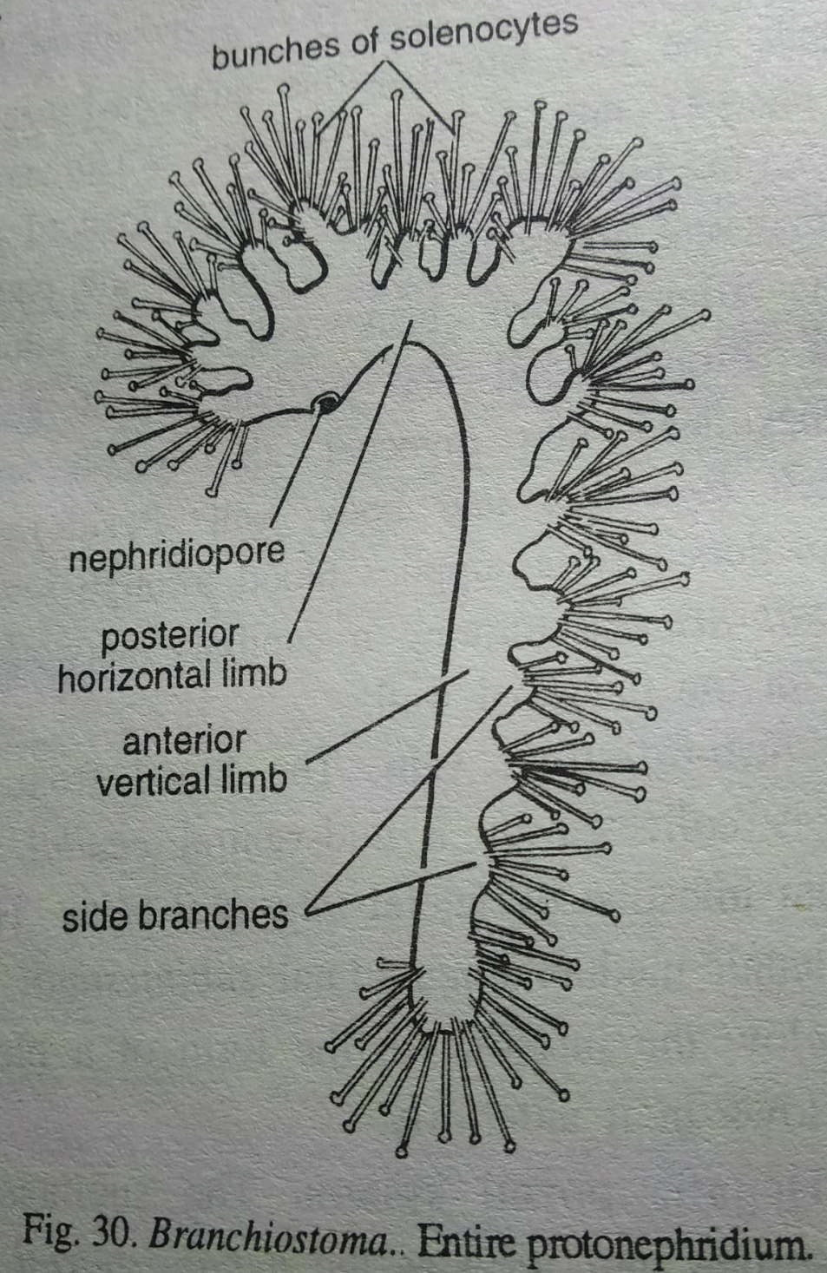
Excretory System

Slide 10
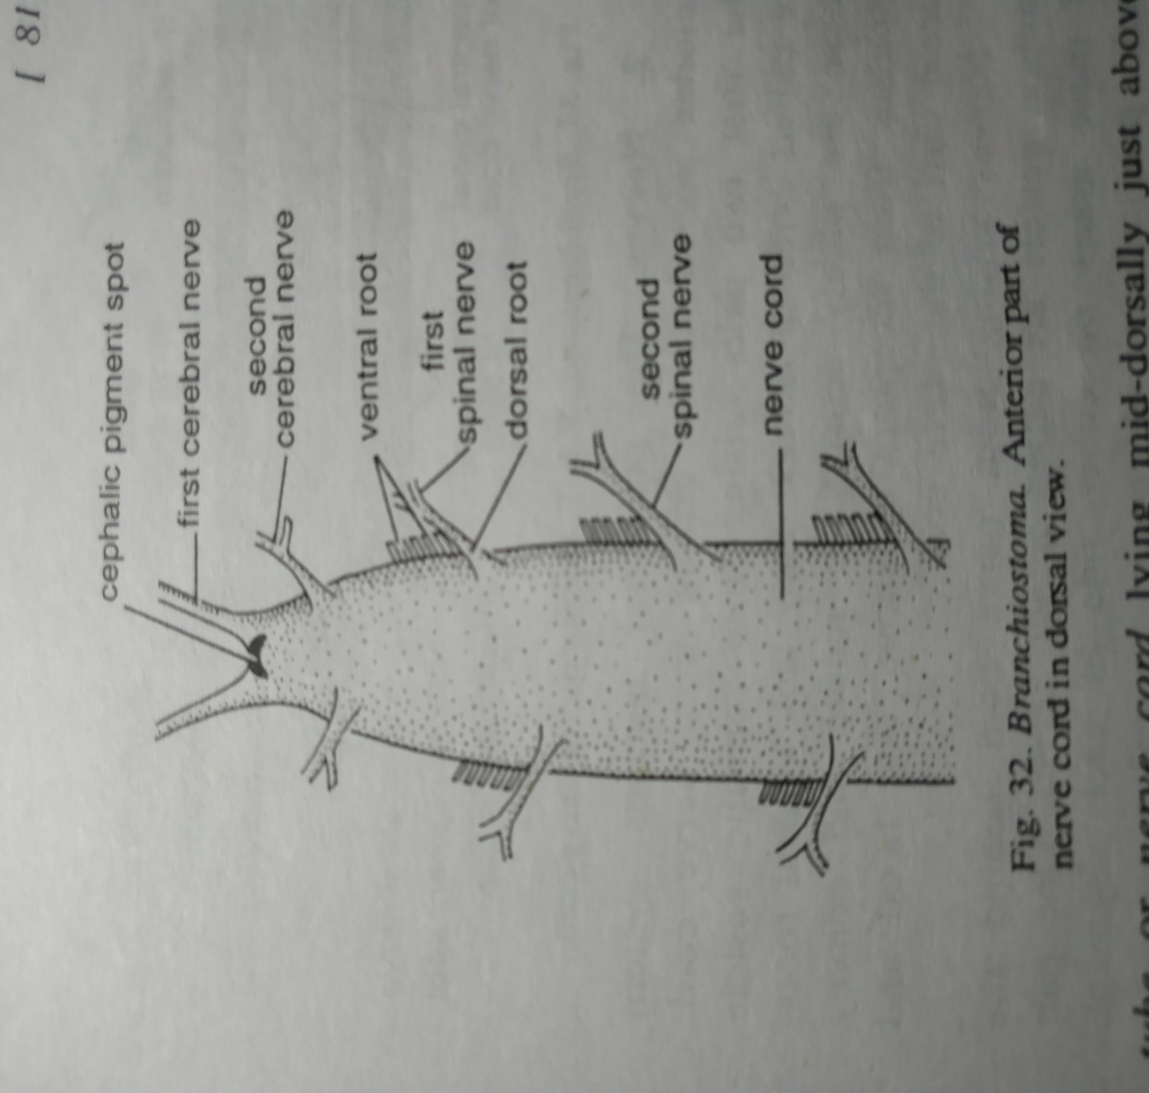
Nervous system

