Slide 1
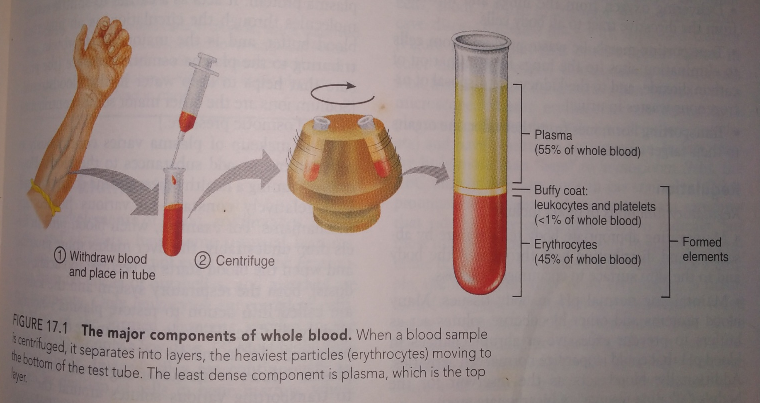
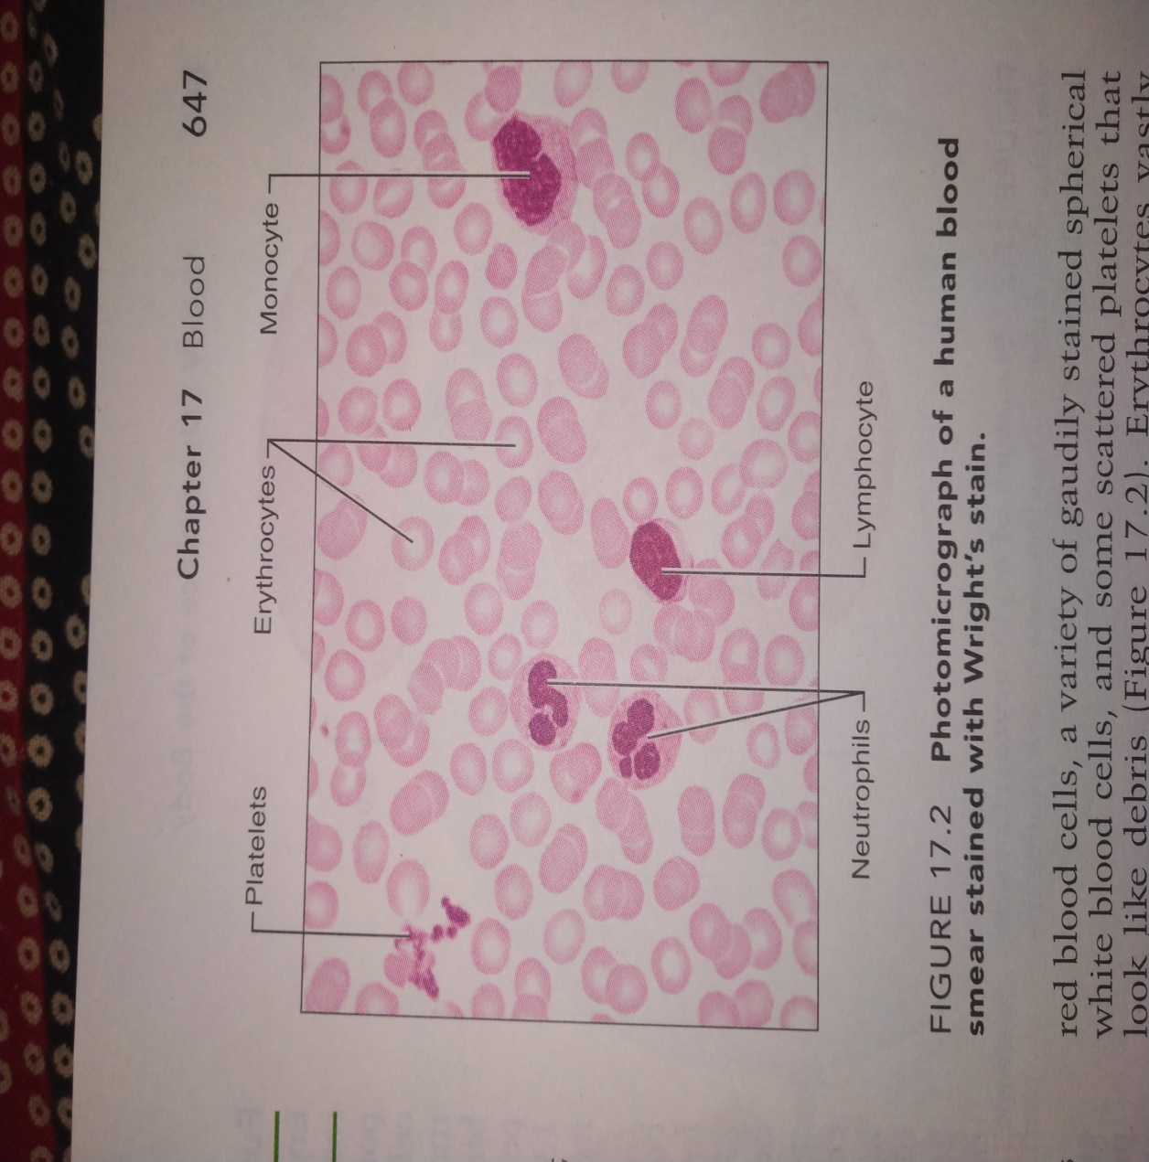
Physiology of Blood

Slide 2
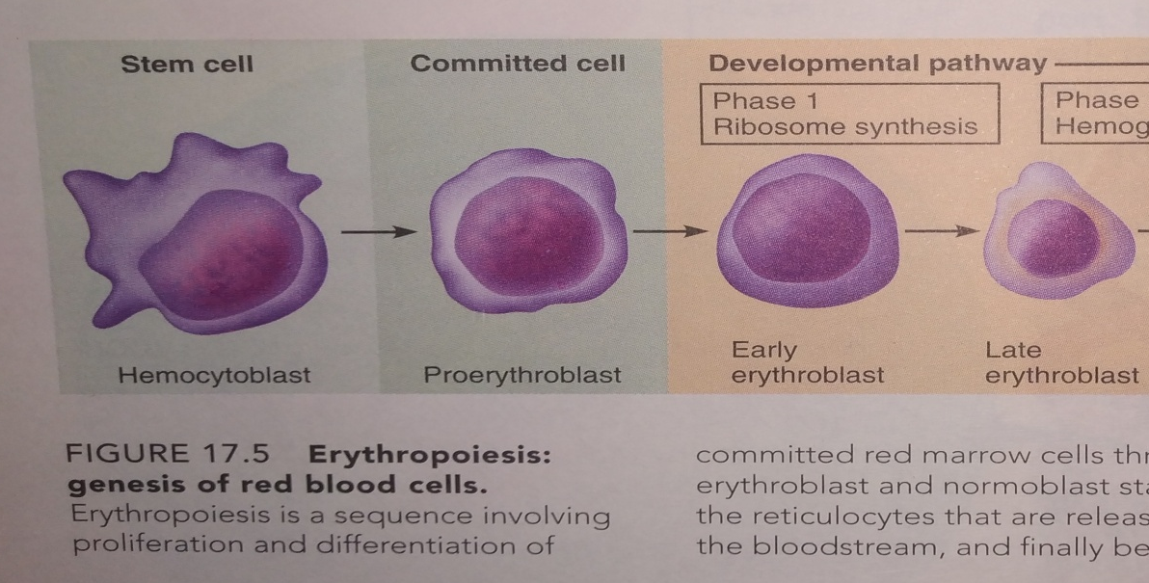
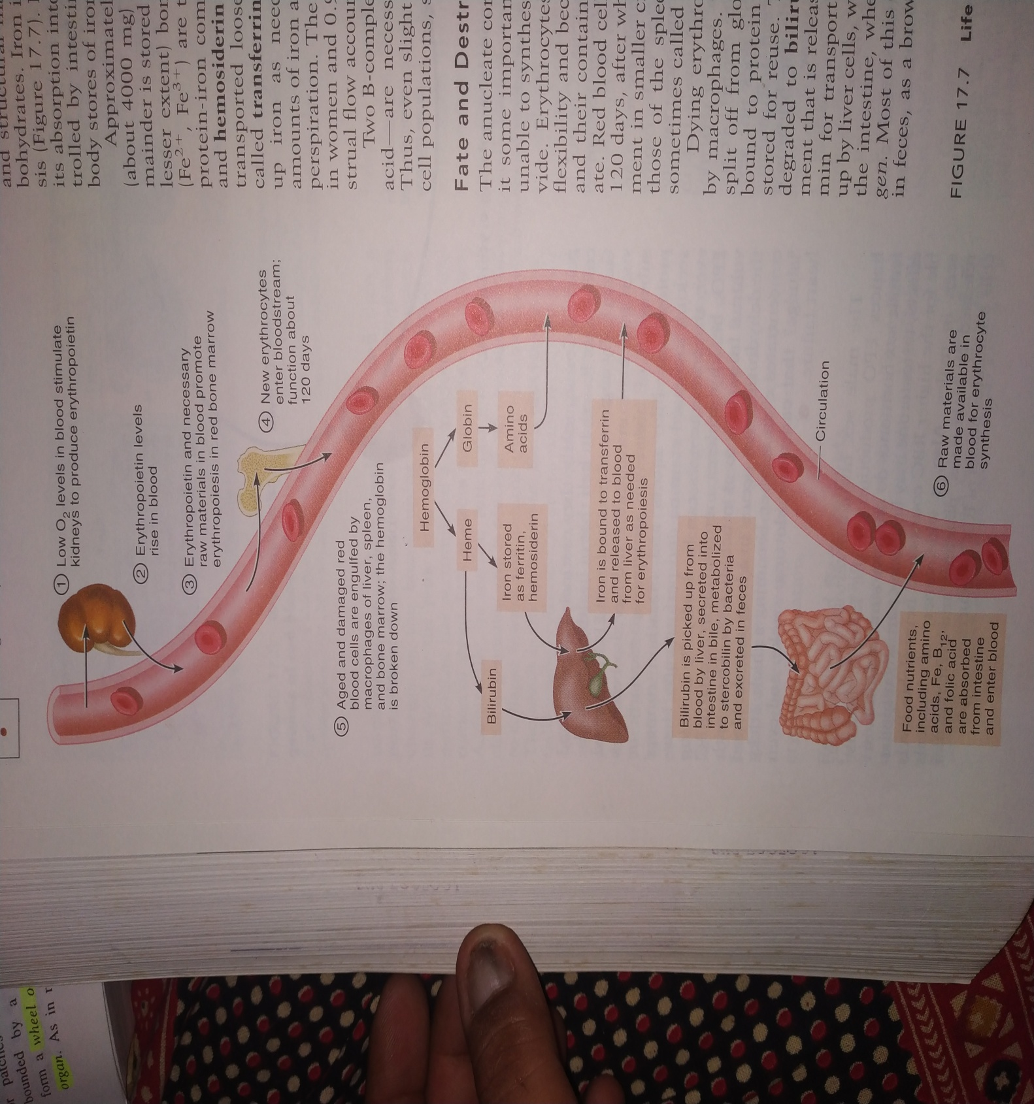

Formation of RBCs (Erythropoiesis
Regulation of Erythropoiesis

Slide 3
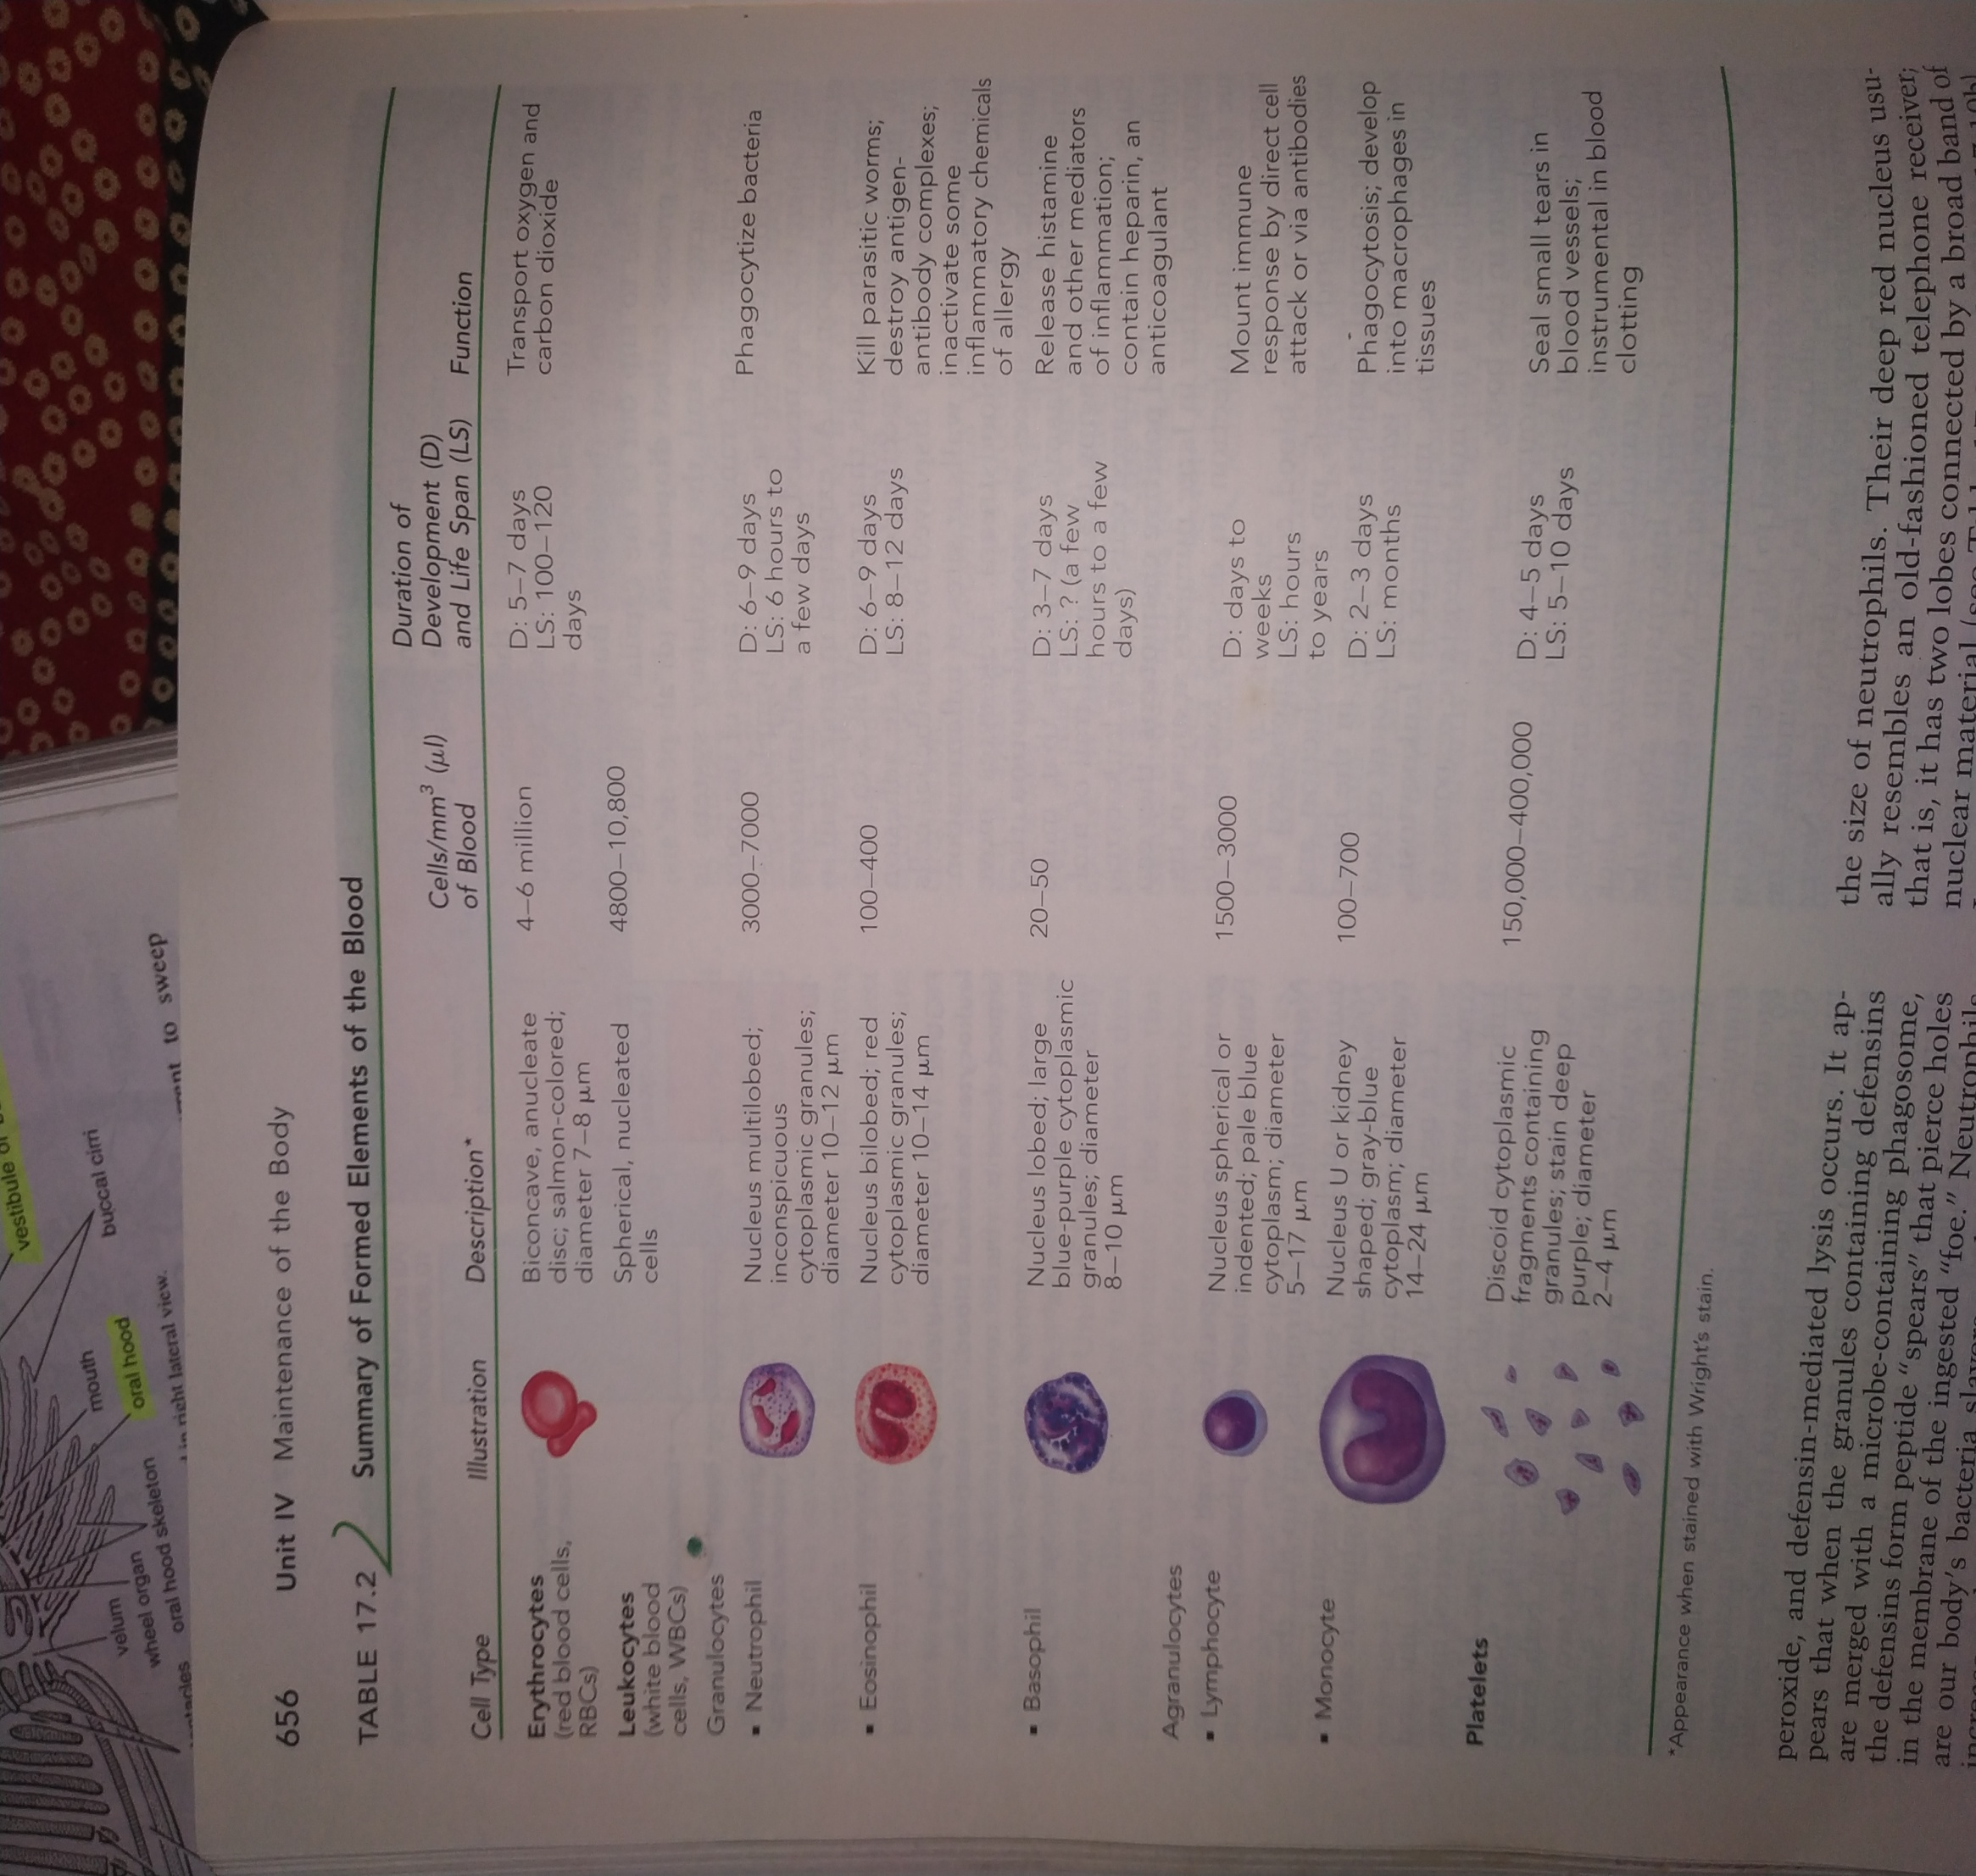

Slide 4
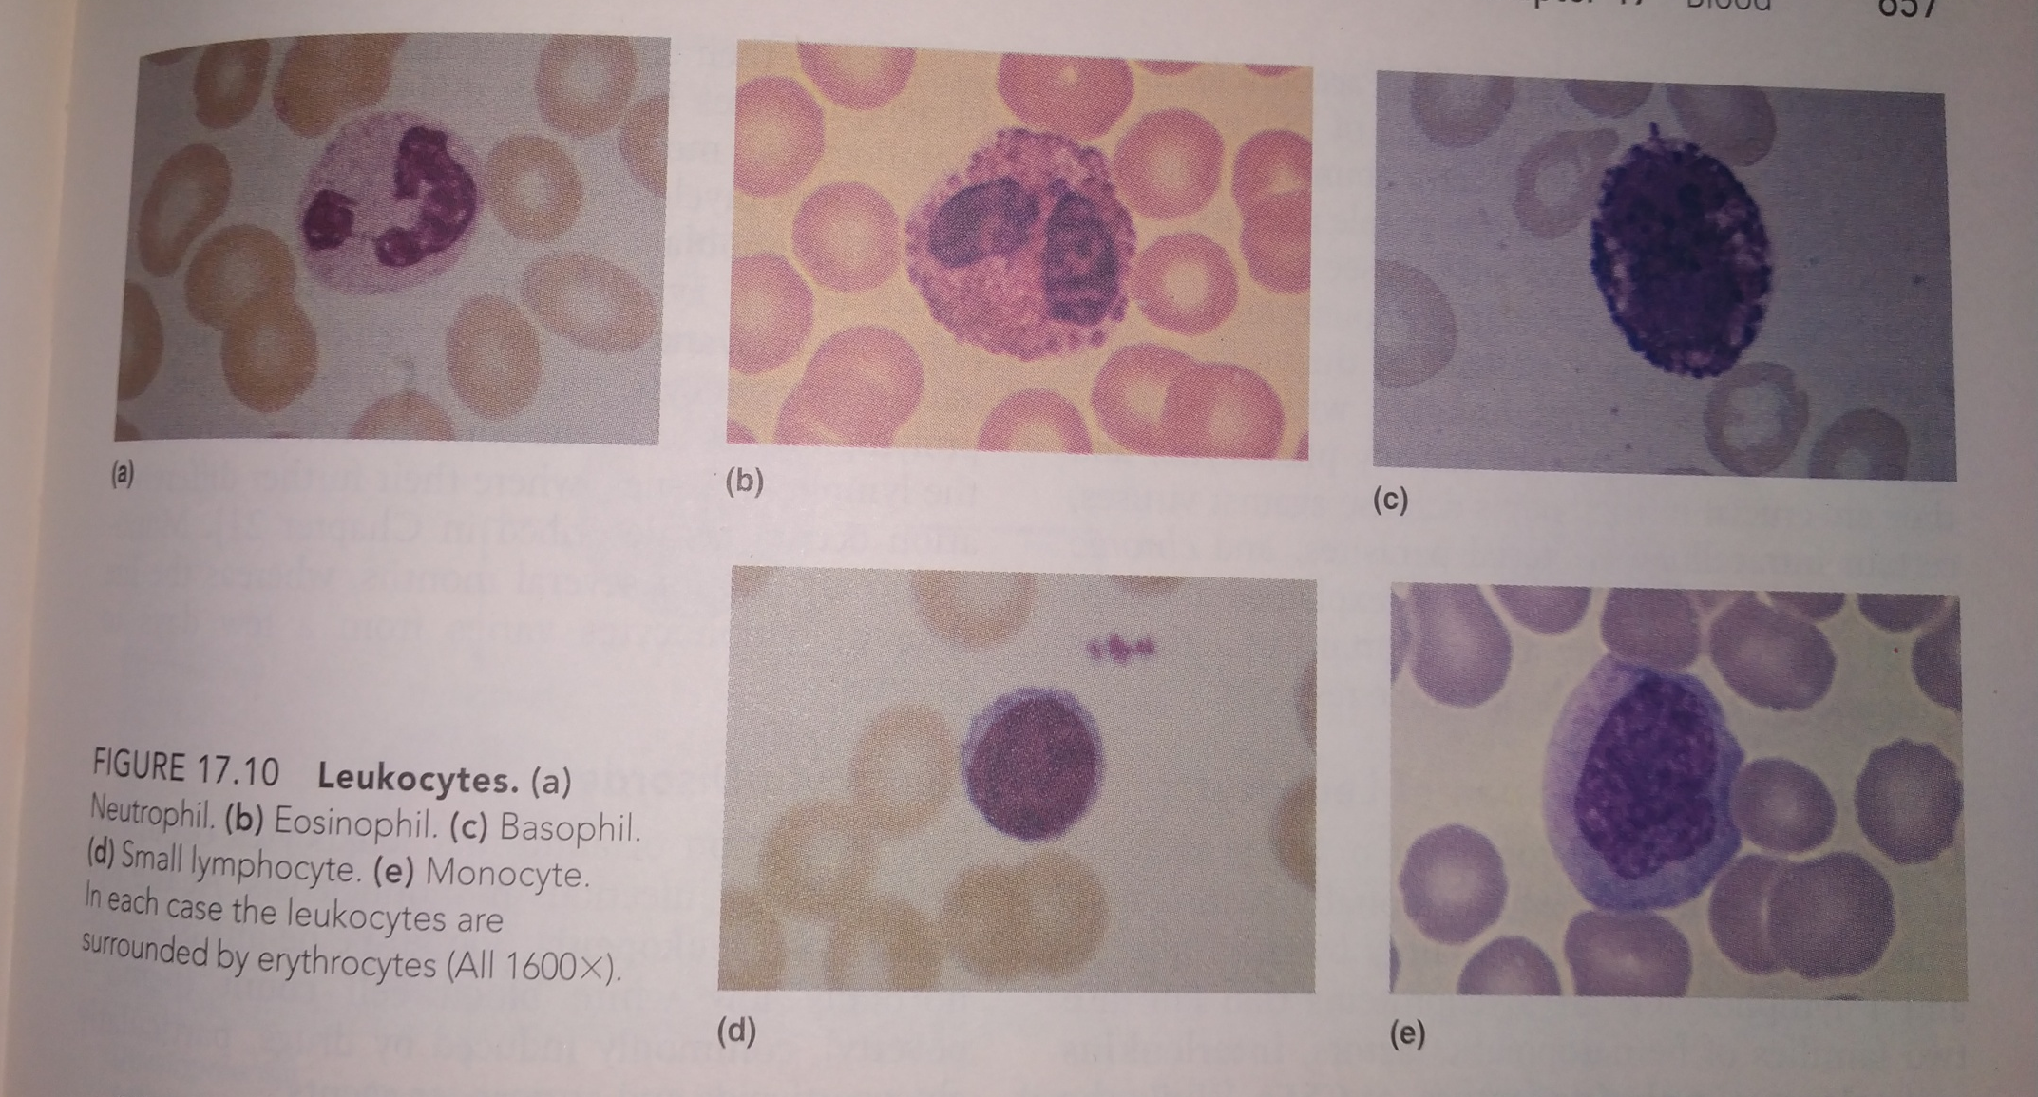
Different WBCs found in Blood

Slide 5
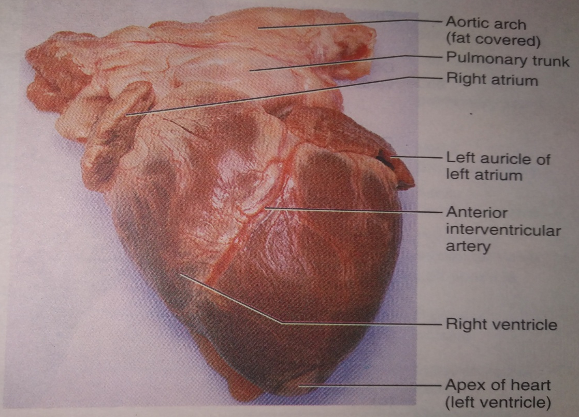
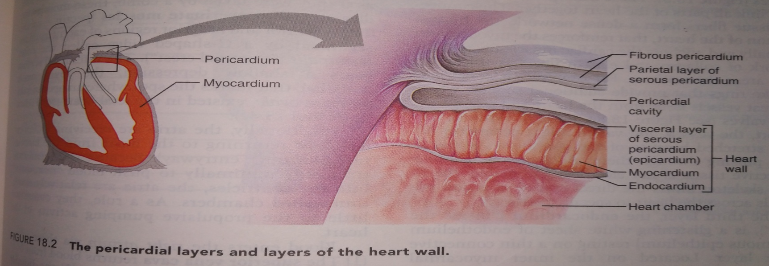
Heart Anatomy
Point of Maximal Intensity (PMI)
The apex touches the chest muscles and the beat can be felt at this region.

Slide 6
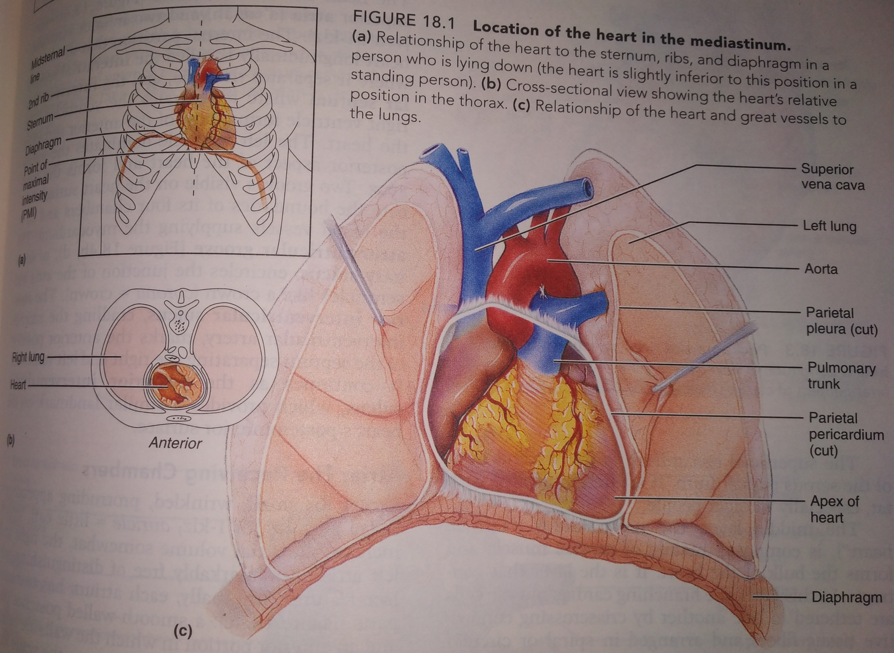

Slide 7
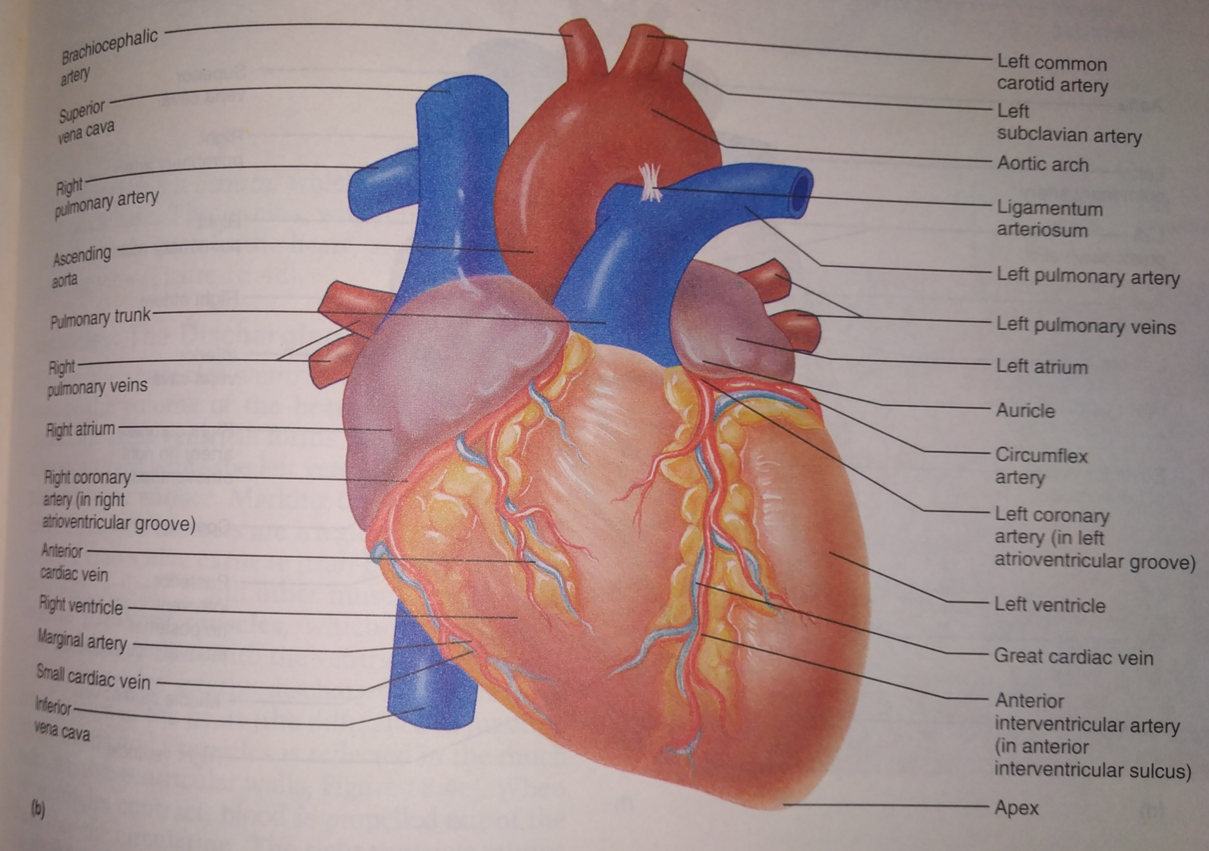

Slide 8
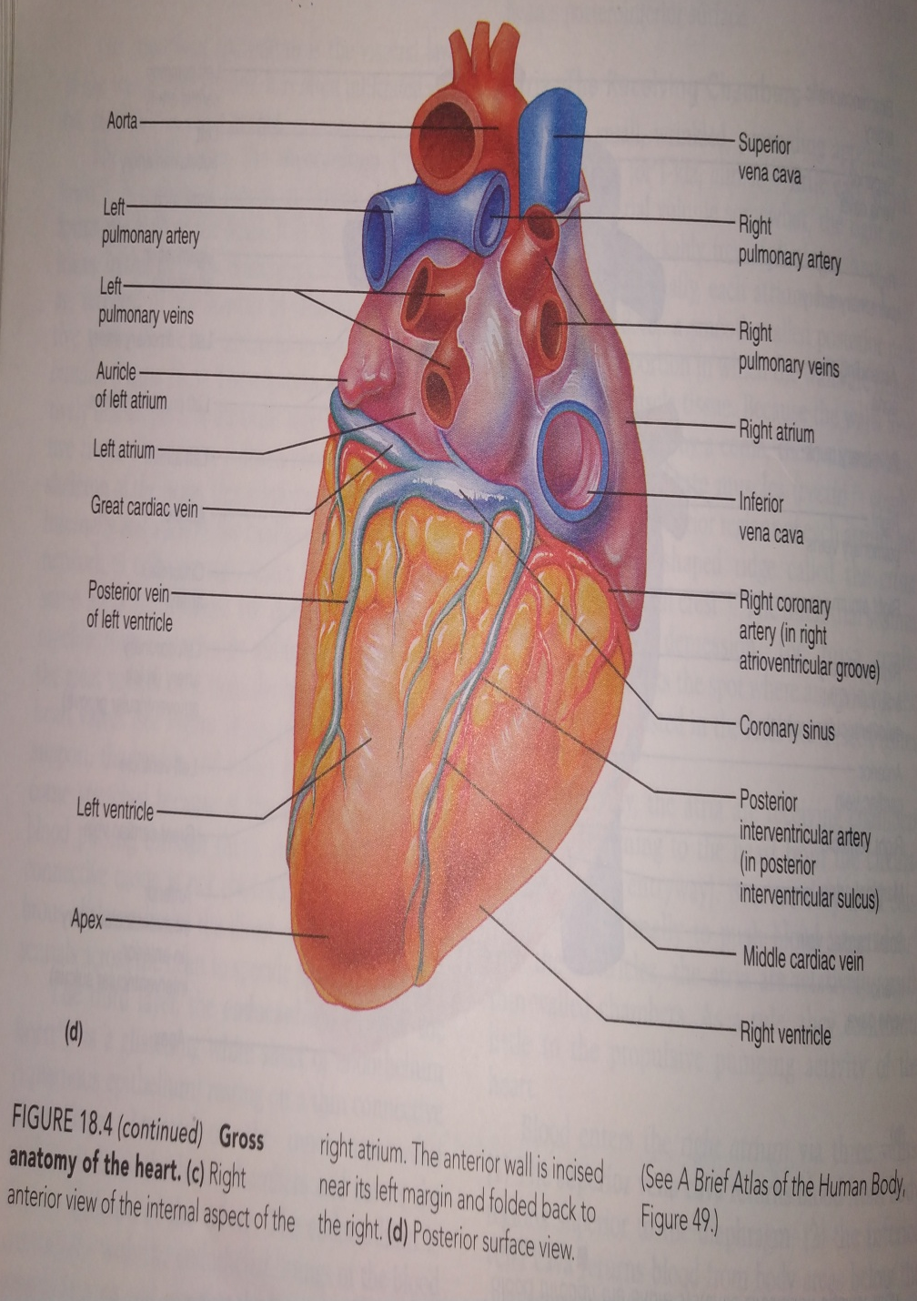
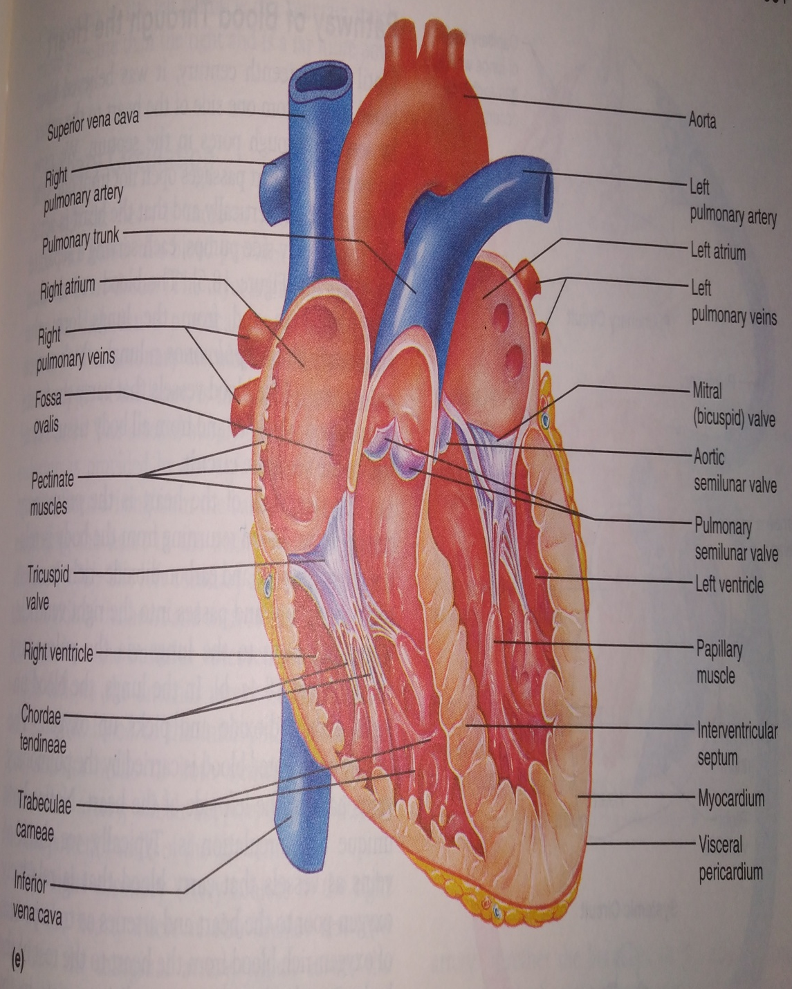

Slide 9
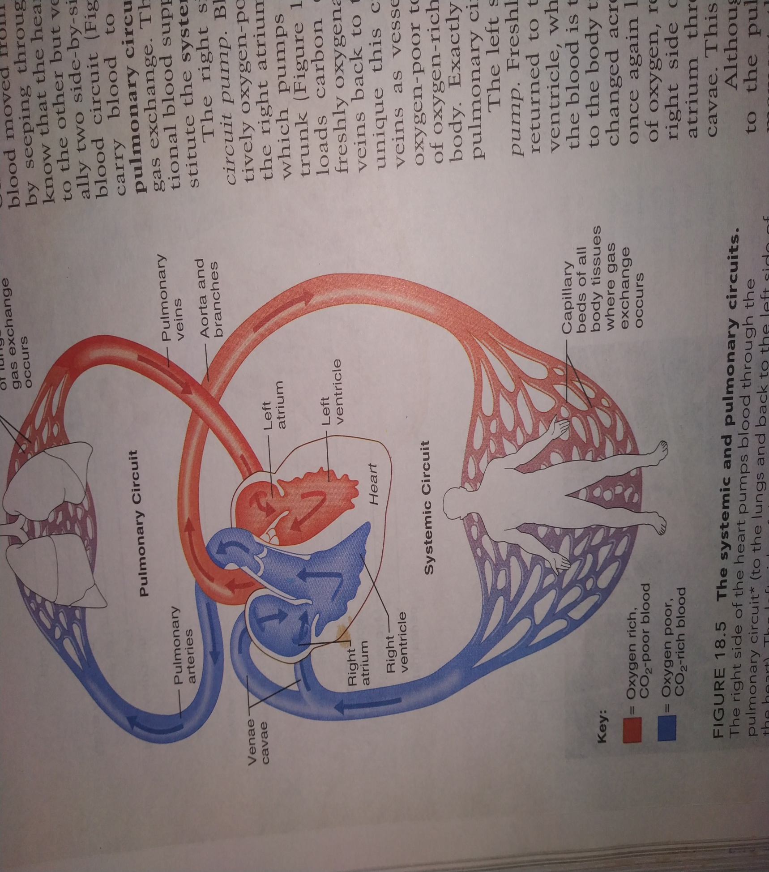
Double Circulation
Systemic Circulation – Collection of deoxygenated blood from the body and distribution of oxygenated blood to the body.
Pulmonary Circulation – Deoxygenated blood sent to the lungs for oxygenation and oxygenated blood brought from the lungs into the heart for distribution

Slide 10
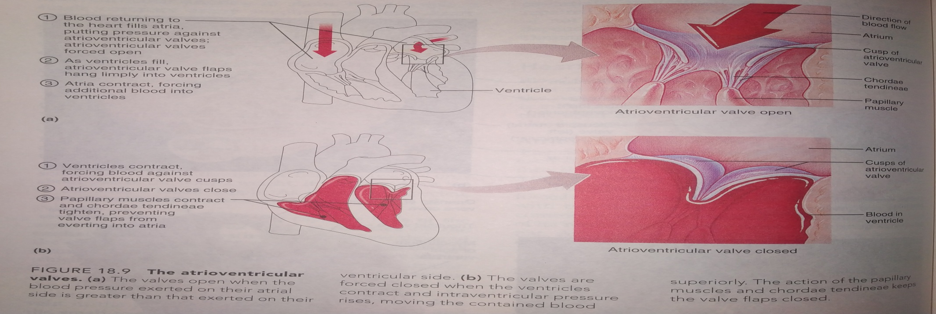
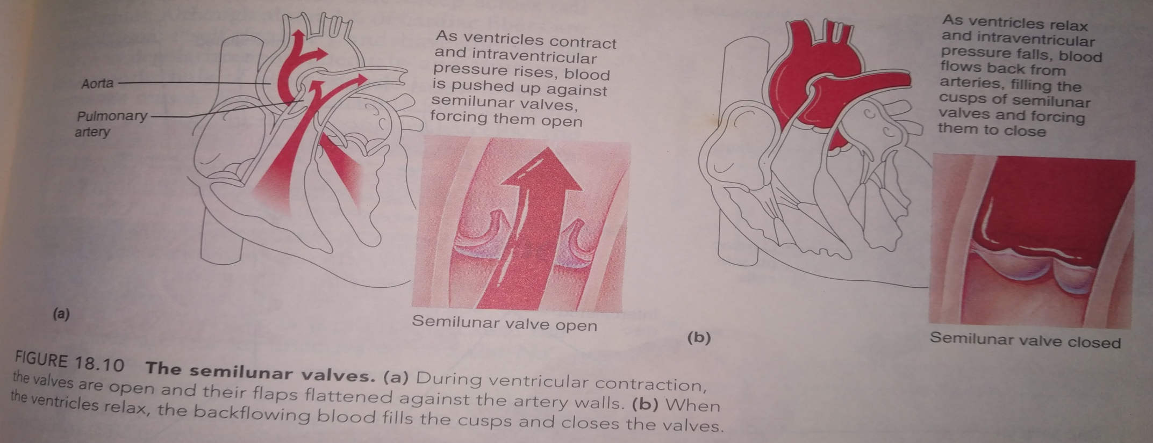

Slide 11
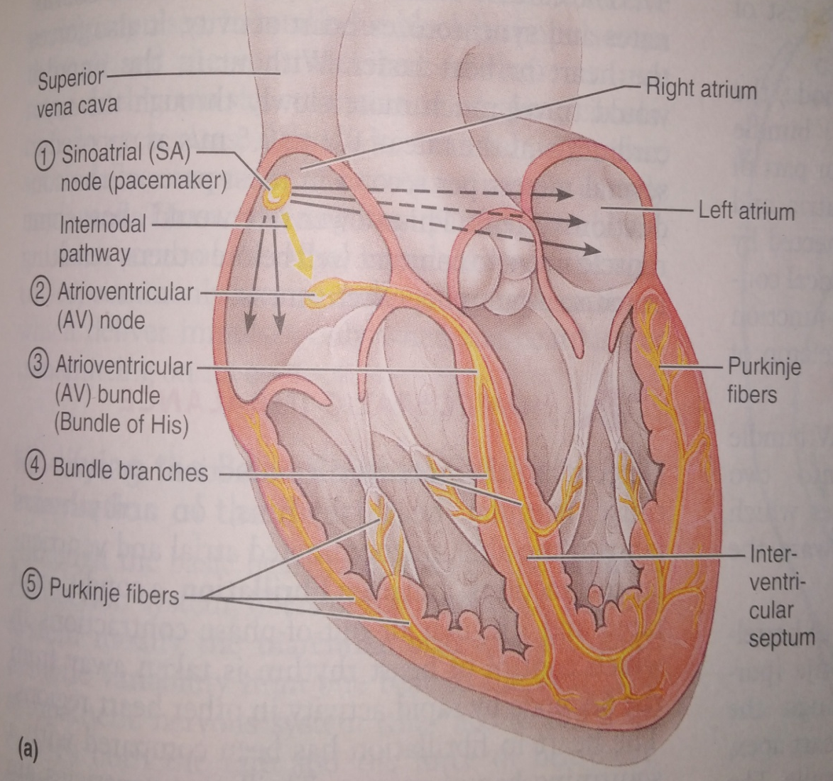
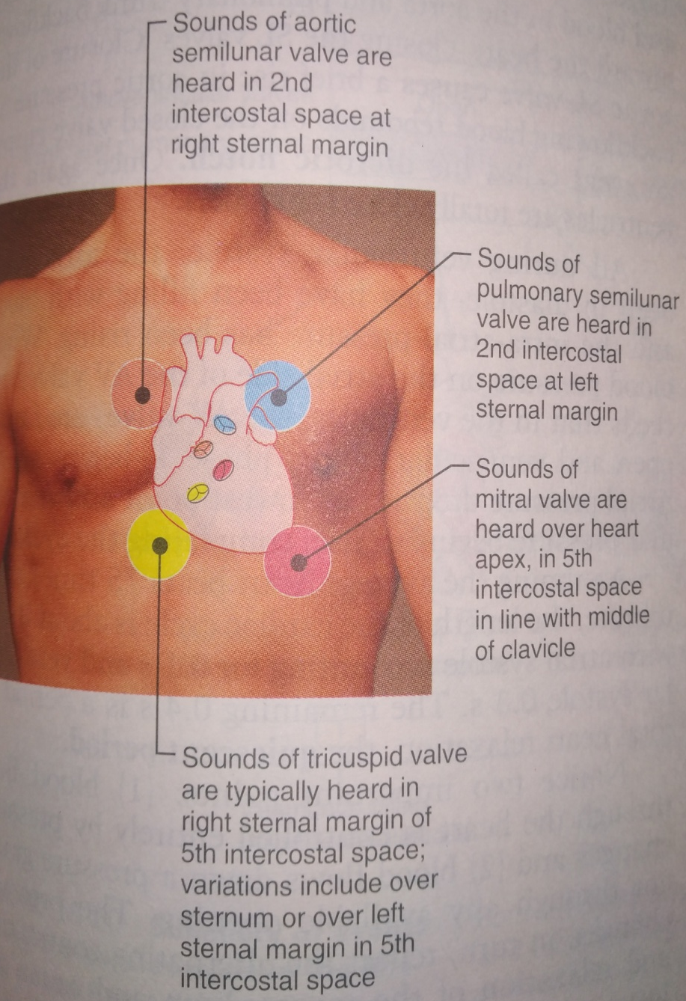
Electrical Conduction
Sounds of the Heart heard at different areas of the chest

Slide 12
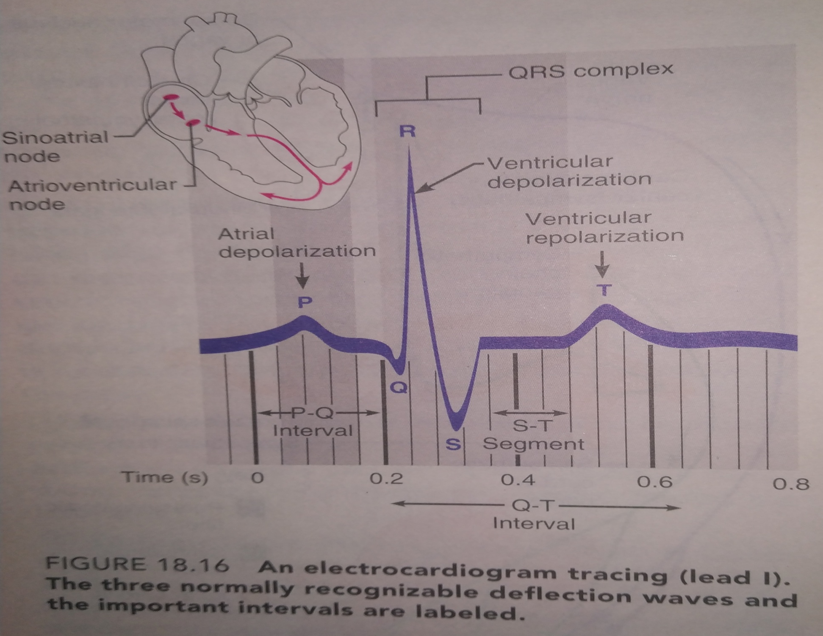
Electrocardiogram (ECG)

Slide 13
