Slide 1
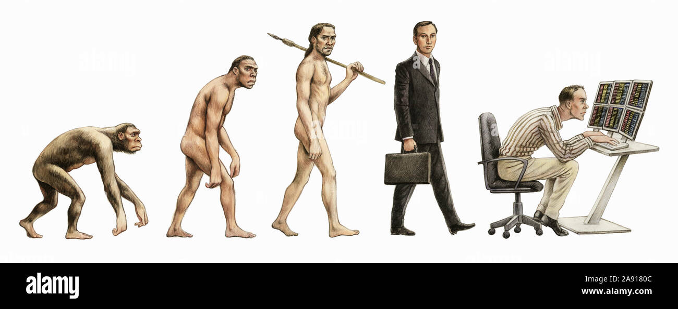
Human Evolution

Slide 2
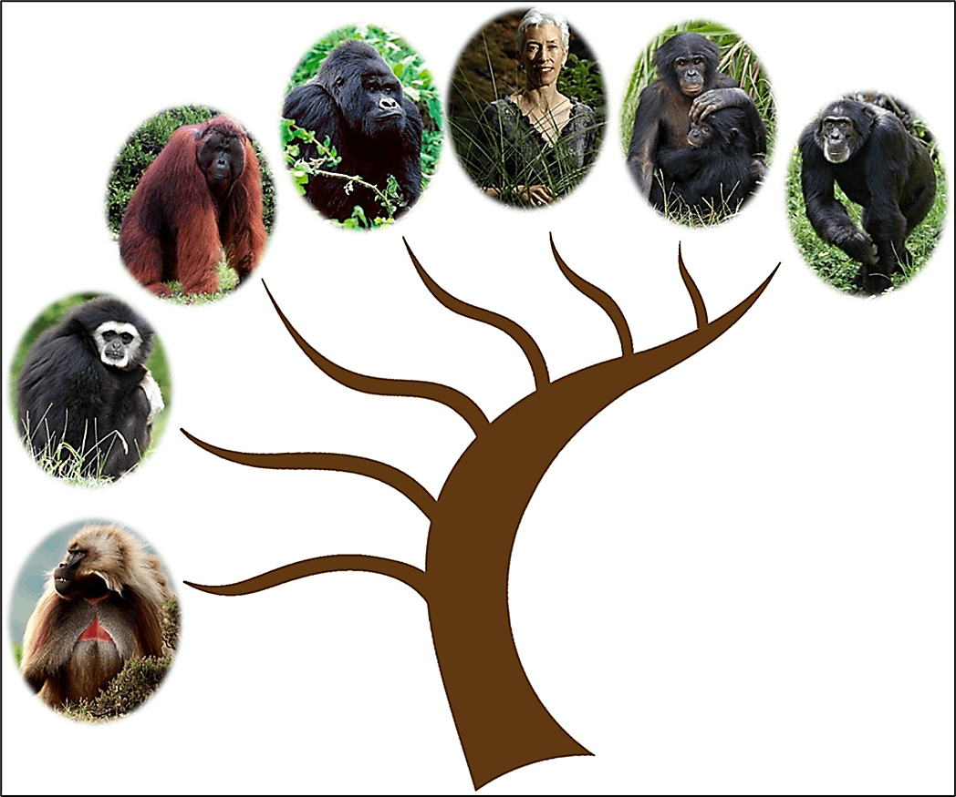
The family to which human beings belong is called Hominidae. It was in the Miocene age that the family Hominidae split from the Pongidae (apes) family. Dryopethicus was the first in the evolution of man in the stages of evolution and some believe him to be the common ancestor of man and apes.

Slide 3
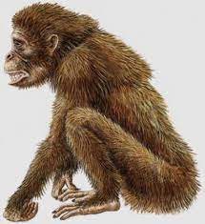
Dryopethicus
He was the earliest known ancestor of man. At the same time as his existence, Ramapethicus existed who was more human-like than Dryopethicus. Dryopethicus inhabited the European region and some parts of Asia and Africa. Stages of evolution of humans began from him. After Dryopethicus and Ramapethicus came to the genus Australopethicus which preceded the genus Homo.

Slide 4
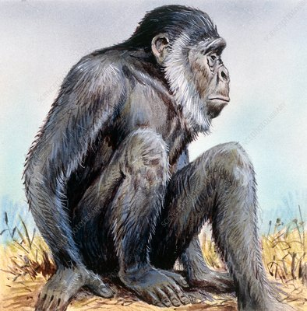
Ramapithecus
The first remains of Ramapithecus were discovered from Shivalik hills in Punjab and later discovered in Africa and SaudiArabia. The region where Ramapithecines lived was not merely forest but open grassland. A hominid status for them is claimed on two grounds: Fossil evidence indicating adaptation including robust jaws, thickened tooth enamel and shorter canines. Extrapolation regarding upright posture and the use of hands for food and defense.

Slide 5
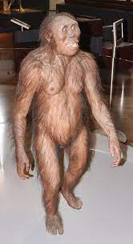
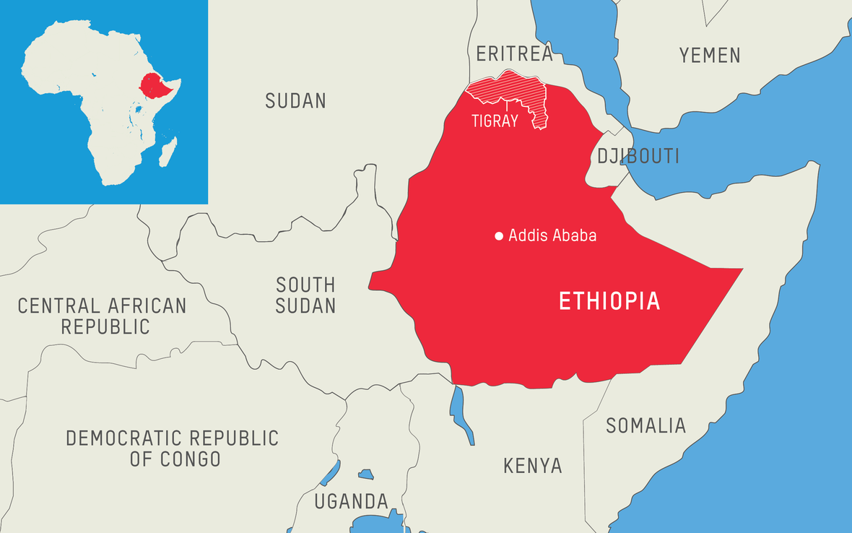
Lucy
The fossil of this female ape-man (called Lucy) was recovered from Afar locality in Hadar, Ethiopia by Donald Johanson (1973). This fossil was probably the oldest among all the primitive man described. The afarensis remains dated between 3 and
4 million years (My) ago.

Slide 6
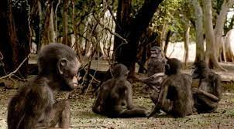
Australopithecus
This group lived 1.5—5 My ago. They had a flattened face. The orientation of the skull relative to the spinal cord, and the bones of the hind-limbs relative to the pelvis suggest an upright gait.

Slide 7
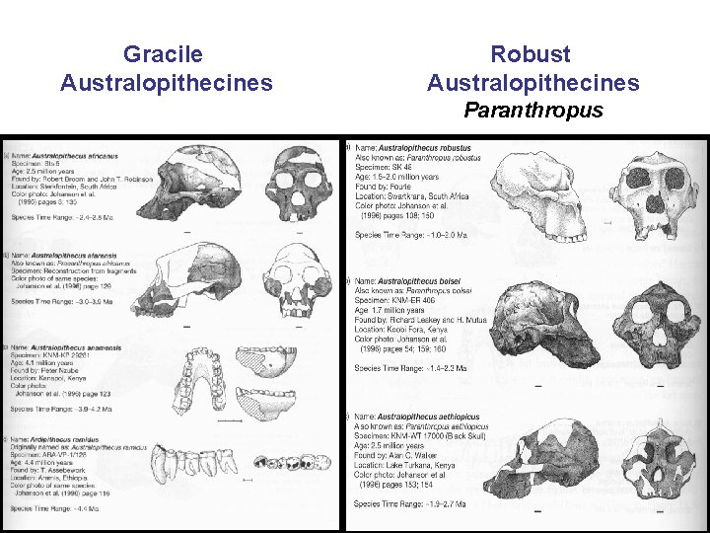

Slide 8
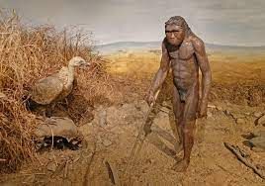
Homo habilis (“handy man”)
Homo habilis (“handy man”). The fossil remains of this hominid were recovered by Leaky in 1964 from rocks of Olduvai Gorge in East Africa. This group lived about 1.5— 2 million years ago.
They had an erect gait, relatively large brains and were tool-users. They fabricated crude tools out of pebbles and used them to gather a variety of plant materials (nuts, seeds, fruits, tubers and roots) and small animals (lizards and rodents).
Co-operative behavior evolved in them and promoted the sharing of the food for the first time.

Slide 9
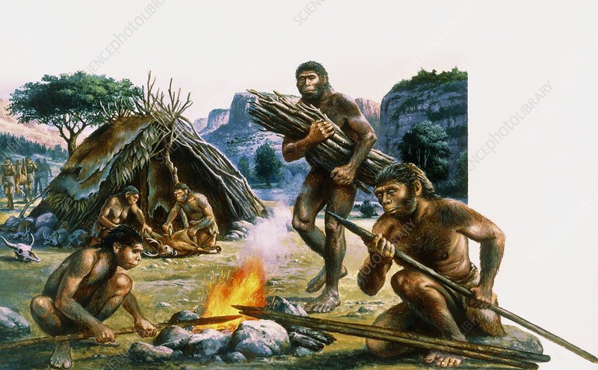
Homo erectus (“upright walking man”)
Homo erectus (“upright walking man”). This group lived 1 million years ago. They had a gait even more like ours and larger brains than the habilines.
H. erectus used tools of bone and stone and used fire.
Fossil remains of H.erectus were discovered at Trinil, Java, in 1894 by Eugene Dubois. They have been called Java men and had a cranial capacity of 775 to 1000 cubic centimetres (or cc).
Another type of fossils of H.erectus, called peking fossils (i.e., Peking men), were discovered by Davidson Black in 1920s. Peking men have the cranial capacity of 900 to 1200 cc.

Slide 10
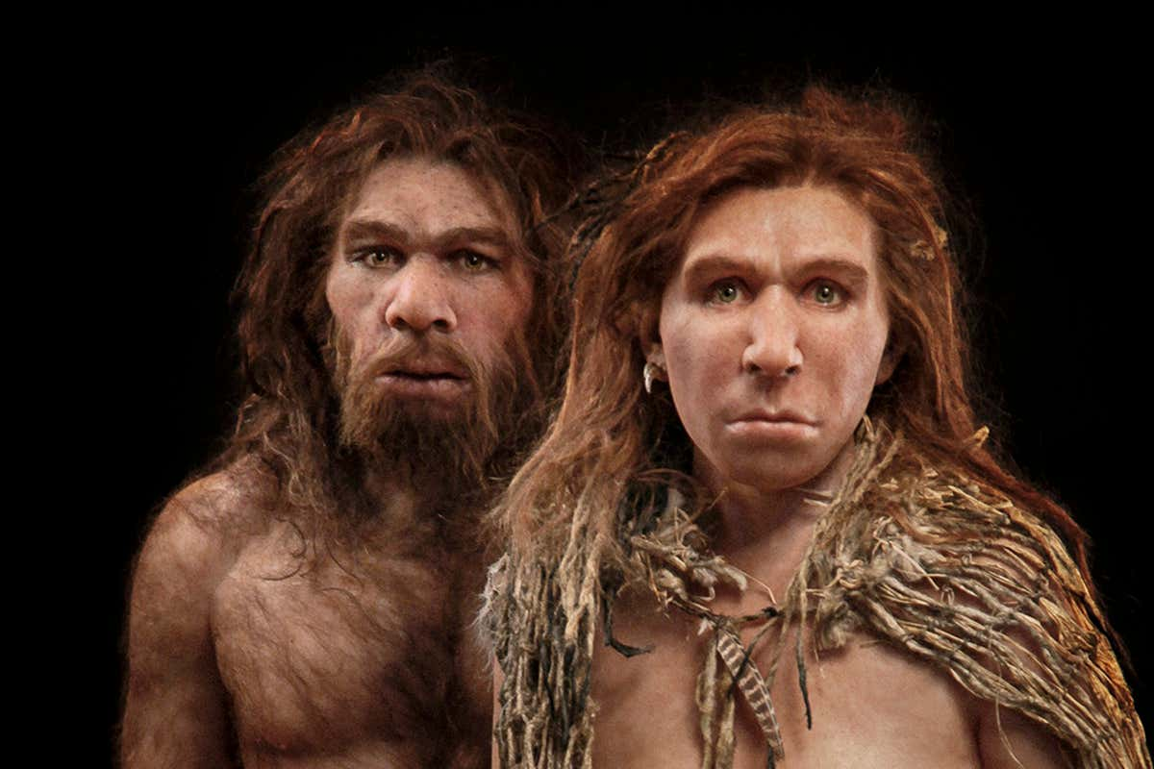
Homo Sapiens Neanderthalensis
Homo Sapiens Neanderthalensis : The Home erectus gradually evolved into the Homo Sapiens. In this transitional event two sub-species of the Homo sapiens have been identified. One the primitive man who has been labeled Homo sapien Neanderthal and two the modern man who is called Homo sapiens sapiens. Most of the evidences about the primitive man that have been unearthed are 75,000 years old. The first fossil that was found of the Neanderthal type was a skull cap found in Germany. The cranial capacity of Neanderthal exceeded that of the modern man. It ranged from 1200 to 1610 c.c. Their culture has come to known as Mousterian culture. For the first time pointed stone flakes which seem certainly to be spearheads have also been found.

Slide 11
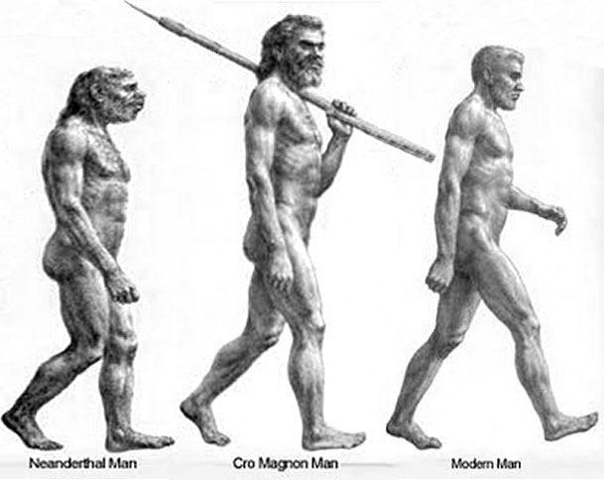
Cro-Magnons (Homo sapiens sapiens)
The fossil remains of Cro-Magnons (Homo sapiens sapiens), a representative of our species, Homo sapiens, were unearthed from a French rock-shelter in the village of Les Ezgies. They were about 35,000 years old. The Cro- Magnon people occurred in Europe and left behind very elaborate cave paintings showing attainment of a form of culture not unlike our own.

Slide 12
