Slide 1
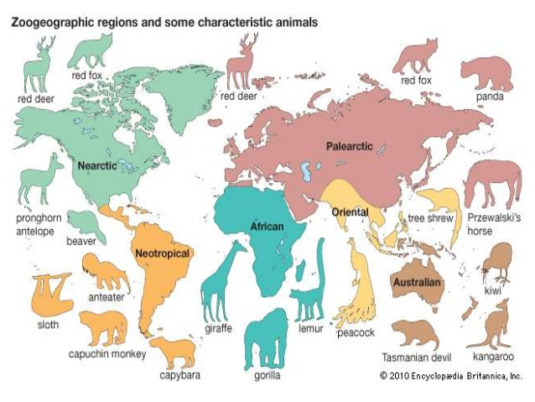
Animal Distribution

Slide 2
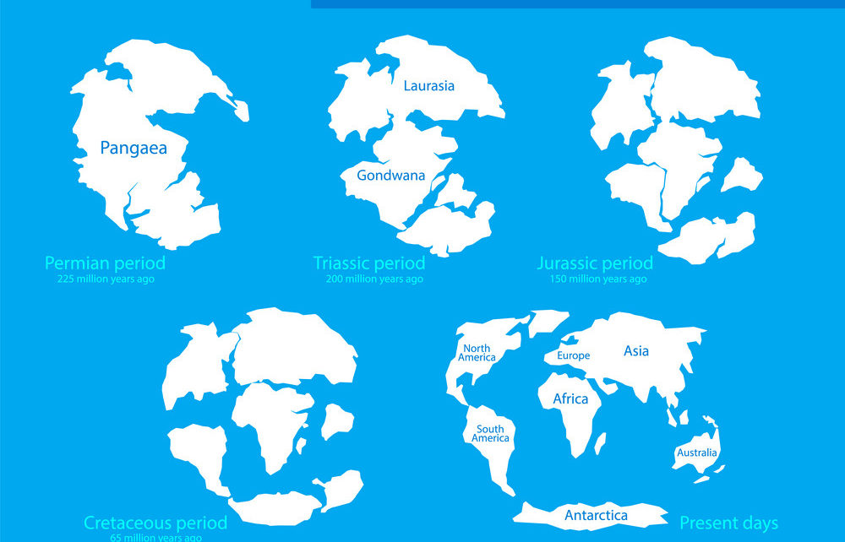
METHODS OF DISTRIBUTION
Continental Drift hypothesis
Centre of Origin hypothesis
Proposed by Wagner, according to him the earth was one whole mass when it was originated, but about 135 million years ago (Cretaceous Period) the land mass fragmented in to continents. With the fragmentation of land mass animals were also distributed in their respective continents
According to this theory the individuals of a species spread out from the centre of their origin because of their high reproductive capacity.

Slide 3
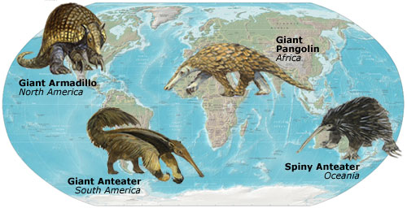
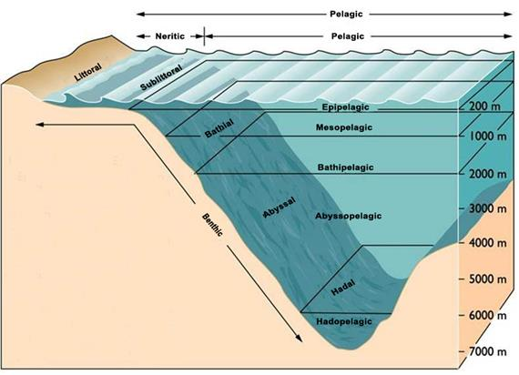
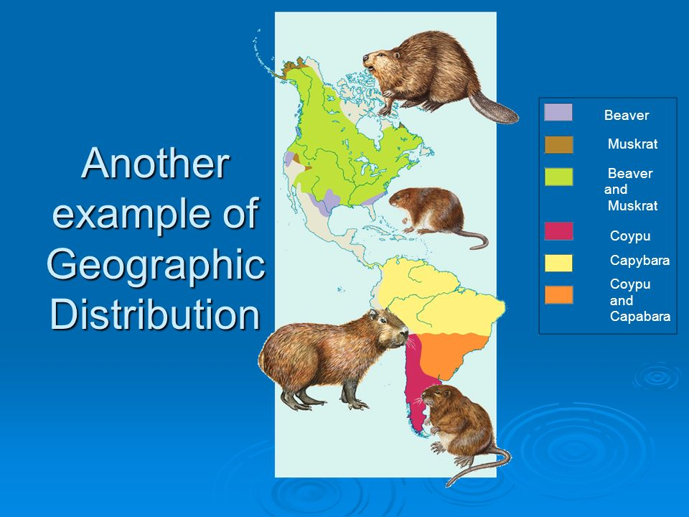
Classification of Animal Distribution
In Time
In Space (land and water)
Geologic Distribution
Durational Distribution
Geographical Distribution
Horizontal or Surface Distribution
Bathymetric Distribution
Vertical or Attitudinal Distribution

Slide 4
Bathymetric distribution includes the following three realms:
(i) Halobiotic, or vertical distribution of organisms in marine (sea) habitat.
(ii) Limnobiotic, or vertical distribution of organisms in freshwater habitat.
(iii) Geobiotic or altitudinal distribution of organisms on land.
All the living organisms in a given region are termed the biota of that region. The animals of a given region are collectively termed the fauna, and the plants of a given region, the flora.
Barriers to Dispersal
1. Topographic Barriers: Alps, Himalayas (High and extensive Mountains
2. Climatic Barriers: Temperature has a marked influence on limiting the animal dispersal, particularly on cold blooded animals e.g. Reptiles and amphibians
3. Vegetative Barrier: The forest become barrier for larger terrestrial animals because they can’t penetrate the forest.
4. Large water bodies: Extensive water bodies form barriers for animals living in water. e.g. Fresh water fishes also prevented to migration, although certain fish such as Salmon, Sturgeon and Smelt (anadromous fishes) migrate from sea water to fresh water annually. While in Eel (catadromous fish) reverse migration occurs.
5. Impurity and lack of salinity of sea water: An effective barrier to the dispersal of certain kinds of marine animals starfishes, squids, sponges and corals because these animals require a maximum purity and salininity of water.

Slide 5
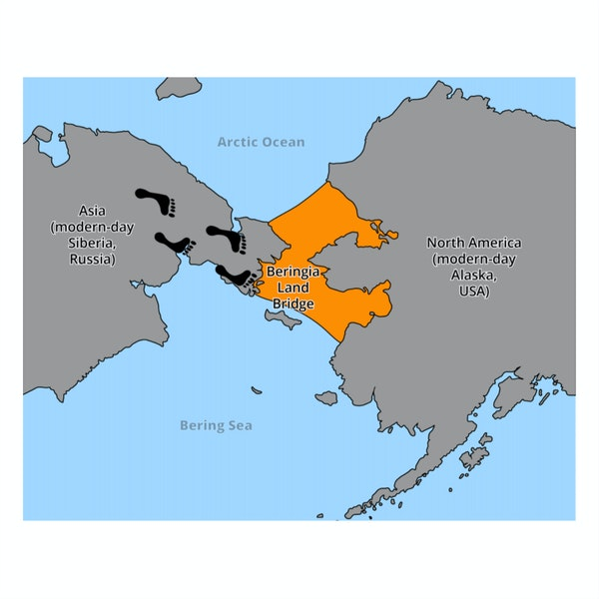
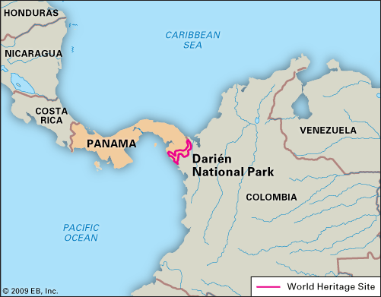
Means for Dispersal
Land Bridges : Panama (a country that links central and south America; in map it shows like a bridge) opens up the avenue for migration of many animals horses, wolves and cats.
2. Natural Rafts and Driftwood : Terrestrial animals also takes lift upon drifting (floating) materials which enable them to accomplished over water journeys. e.g. Polar bear are also carried by floating shore ice.
3. Favoring Gales : Many animals like insects, bird, and bats dispersed by strong wind and they get their favorable destinations. e.g. European birds transported to America by way to Iceland and Green land

Slide 6
PATTERNS OF DISTRIBUTION OF BIOTA
1. Distribution
(i) Continuous distribution. A taxon distributed throughout the world in all climatic zones or
in all the continents in at least one climatic zone is said to have continuous distribution. It is of the following types :
A. Cosmopolitan distribution: Such a taxon or a species occurs in all climatic zones. The
common plants species of nearly cosmopolitan distribution are Chenopodium album, Taraxcum
officinale, Phragmites communis. Among the animals the following species have cosmopolitan distribution : Tyto alba (Barn Owl), Ardea cineria (Grey Heron), Falco pereginus (Falcon), Vanessa cardui (Butterfly).
B. Circumpolar distribution: Certain species such as, Saxiphraga oppositaefolia (Arctic plant) Carex lapponica (Angiosperm), are distributed in a belt around the north-pole.
C. Circumboreal and circumaustral distribution. The species which are distributed in a near continuous belt in the temperate region of northern or southern hemisphere are said to have
circumboreal and circumaustral distribution respectively. The genera Alnus, Draba, Acer, etc., are
circumboreal in distribution and Danthonia is circumaustral in distribution.
D. Pantropical distribution. Certain plant species such as Bauhinia, Dalbergia, Dioscorea, Corchorus, Ocimum, Cassia, Eugenia, Phyllanthus, etc., are distributed throughout the tropical belt.
(ii) Discontinuous distribution. A taxon distributed in two or more widely separated geographical areas, is said to have discontinuous distribution. Dipnoi fish, Epiceratodus, Protopterus and Lepidosiren are distributed in Australia, Africa and South America.

Slide 7
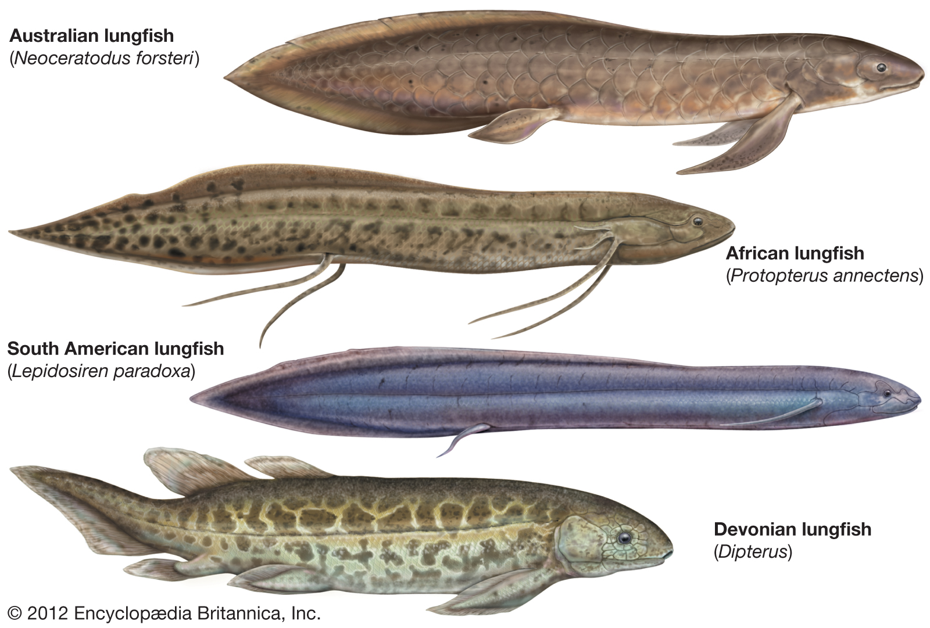
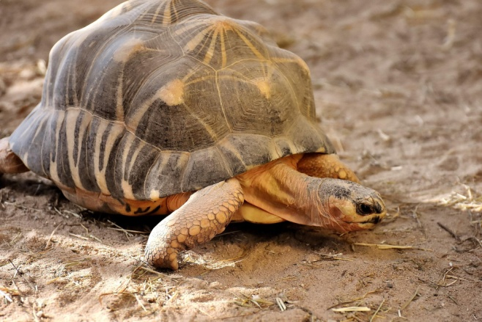
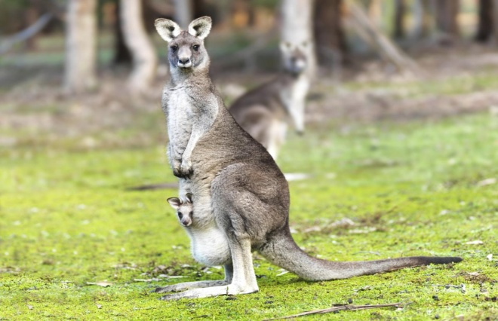
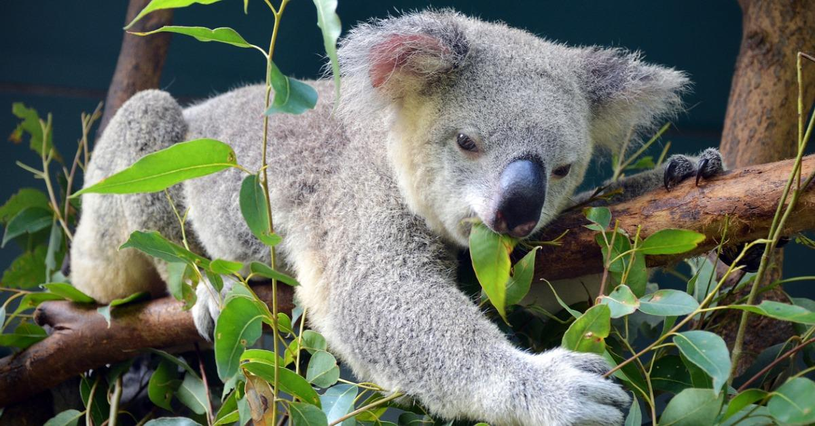
Endemism
Endemic species are restricted in their distribution to a small region. This phenomenon of restricted distribution associated with some geographical or ecological factors is called endemism. Numerous plant families, genera and species are found to be highly endemic. In the Himalayas, some 28% (3,169 dicot species) of all the dicots are endemic

Slide 8
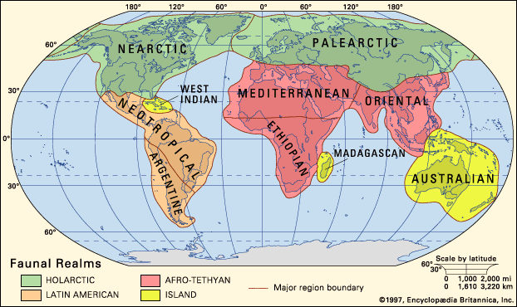
Zoo-Geographical Realms
6 zoogeographical regions first recognized by Clater (1858), modified by Huxley (1868), extended by Wallace (1876) and best described in a modern way by Darlington (1957) and others. The six zoogeographical regions are the Palaearctic, the Nearctic, the Neotropical, the Ethiopian, the Oriental and the Australian. Because some zoogeographers consider the Neotropical and the Australian regions to be so different from the rest of the world, these two are often considered as regions or realms equal to the other four combined. They are classified as Neogea (the Neotropical), Notogea (the Australian) and Metagea (the Palaearctic, Nearctic, Ethiopian and Oriental). Moreover, two zoogeographic regions, namely the Palaearctic and the Nearctic are quite closely related, so the two often considered as one, the Holarctic.

Slide 9
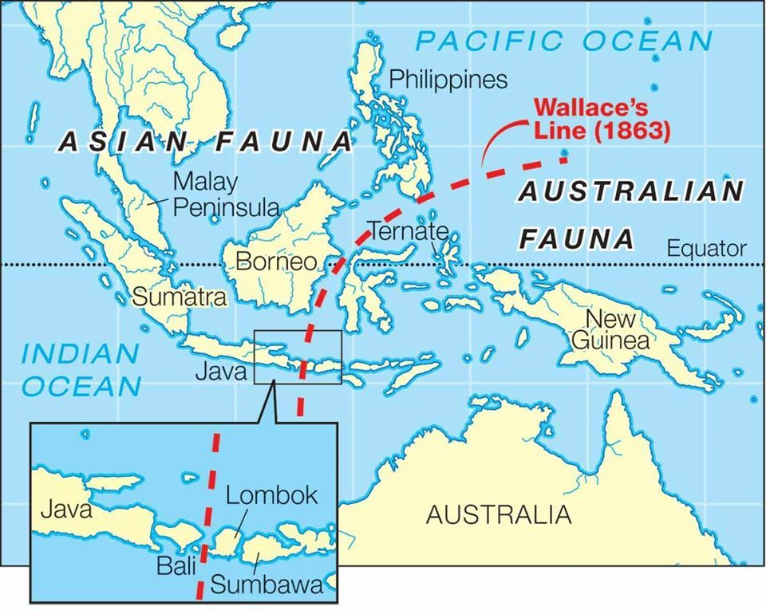
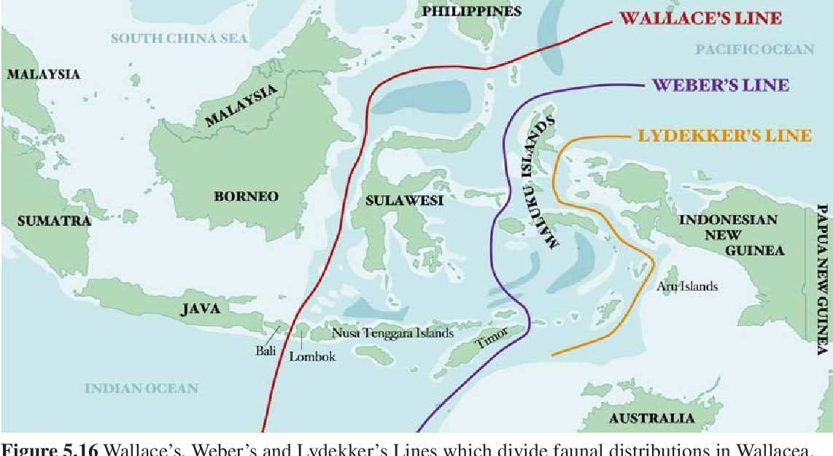

Slide 10
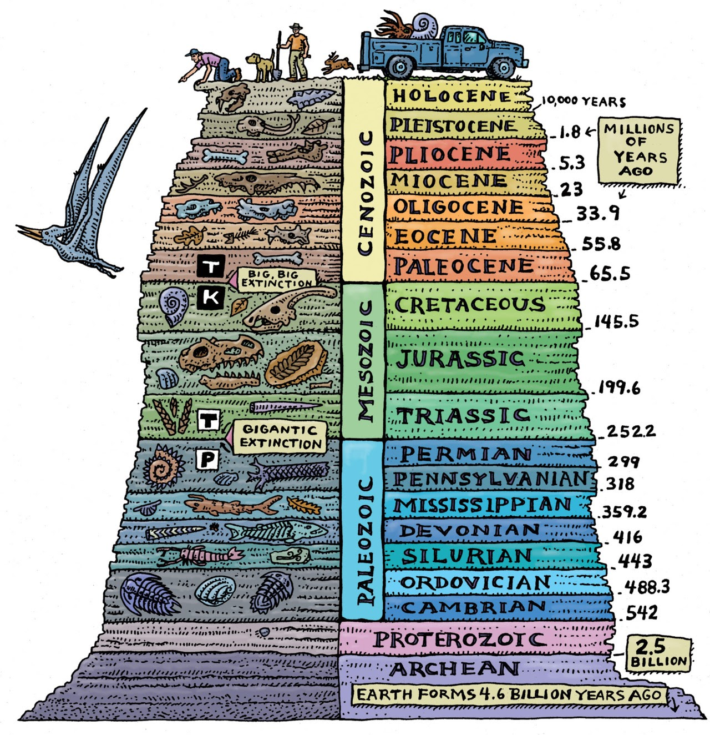
Geologic Distribution
Durational Distribution

Slide 11
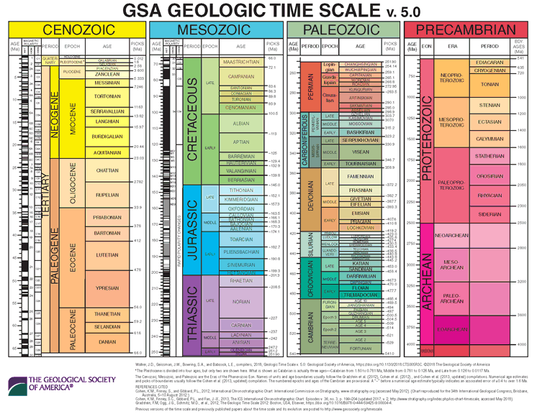

Slide 12
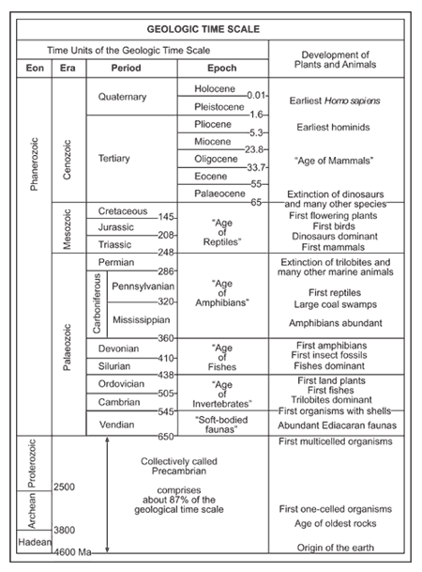

Slide 13
