Slide 1
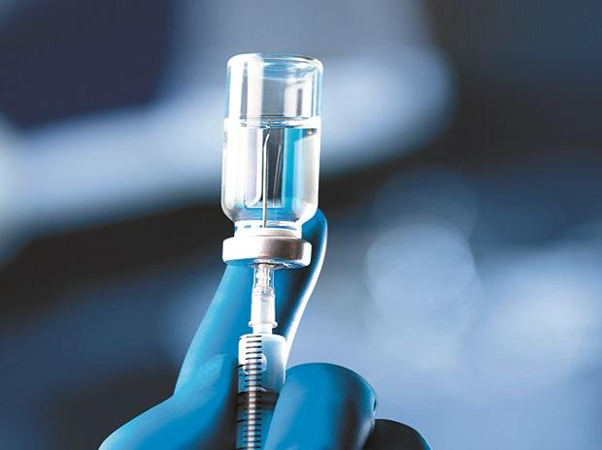
Vaccine Immunology

Slide 2
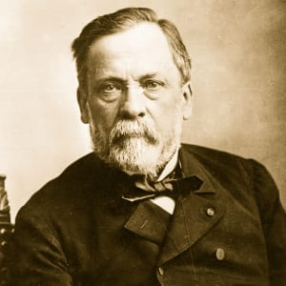
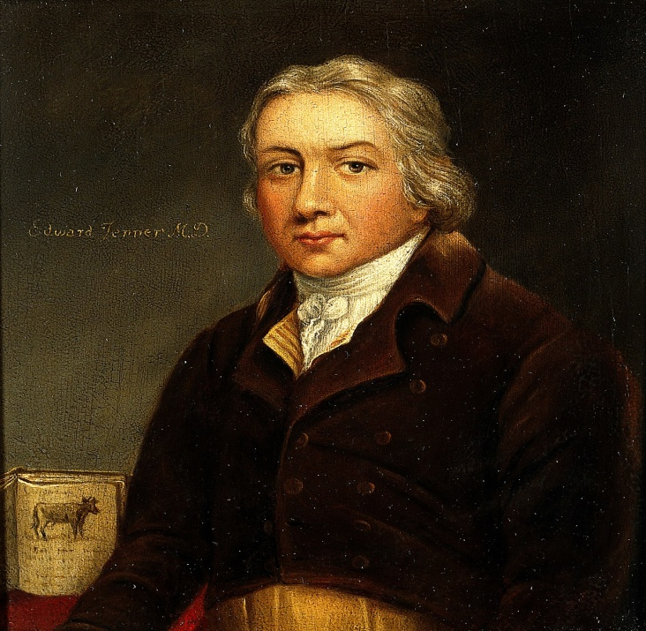
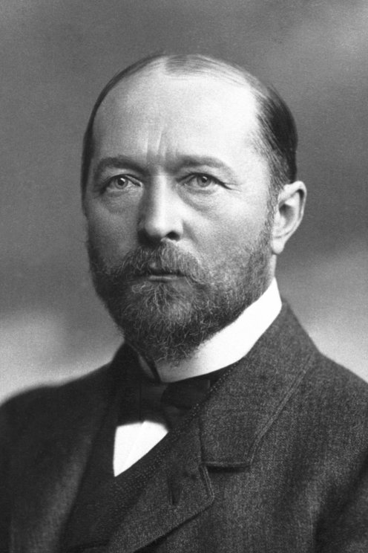
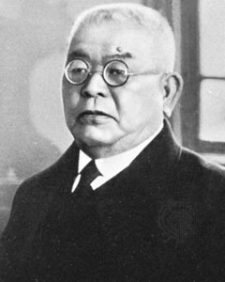
Louis Pasteur
Edward Jenner
Emil von Behring
Hidesaburo Kitasato

Slide 3
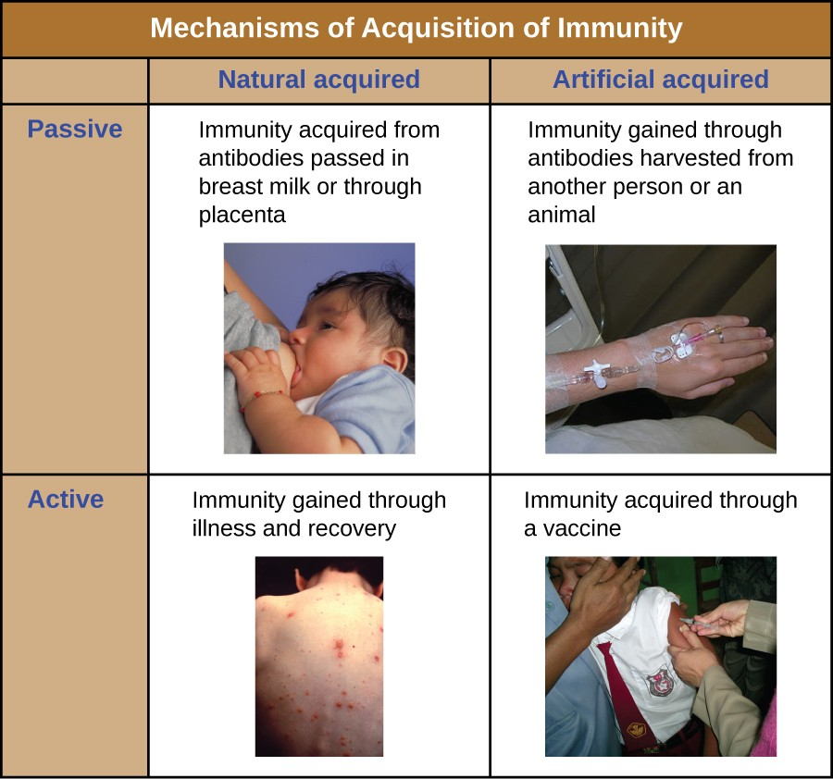

Slide 4
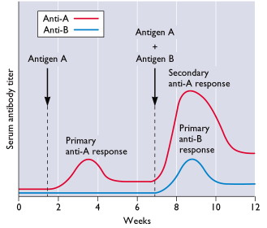
When majority of a population is immunized, the chances of a susceptible individual contacting a potential infected individual and getting infected subsequently is very low. This phenomenon is called HERD IMMUNITY.

Slide 5


Designing a Vaccine
Challenges
Majority of Infections dealt by the Innate Immune system.
Measurable immune response does not guarantee efficacy.
Branch of immune system activated is critical.
Immunological Memory formation.
Incubation period of pathogen.
It’s not only about the Jab only. It’s way more complicated

Slide 6
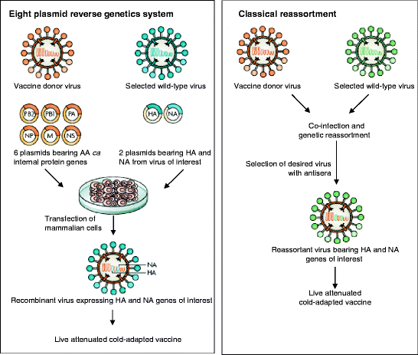
Live Attenuated

Slide 7
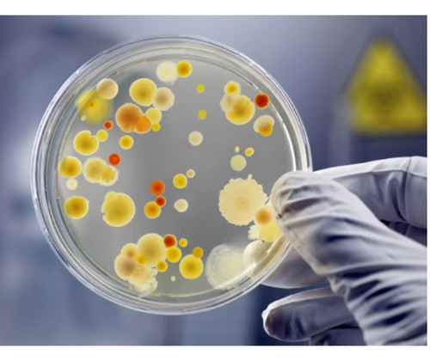
Growing pathogenic bacteria in abnormal culture medium
Some of the Bacteria gets adapted to the conditions of culture
Selection of Adapted Strain
The Live Attenuated vaccine is ready. It will illicit the immune response but not grow in normal body conditions

Slide 8
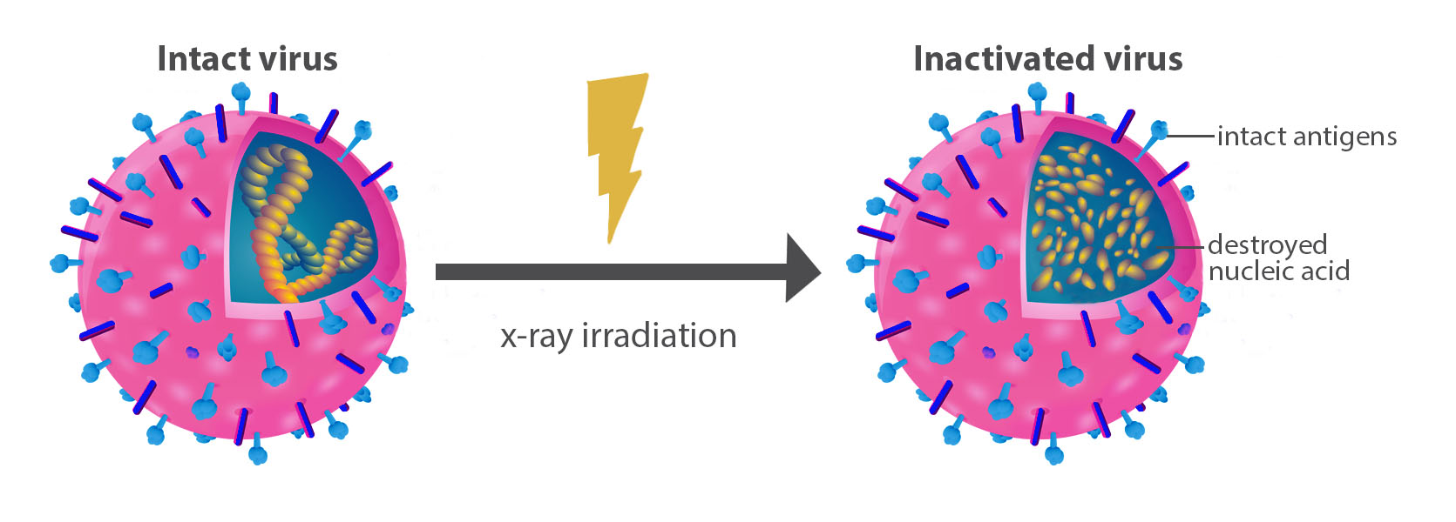
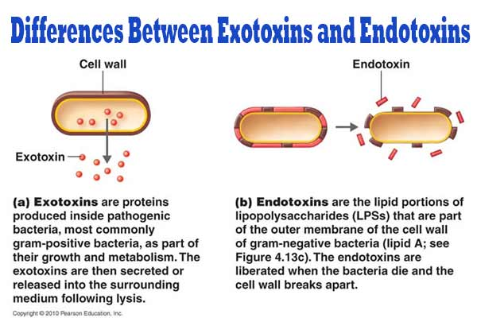
Inactivated or Killed Vaccines
Subunit Vaccines

Slide 9
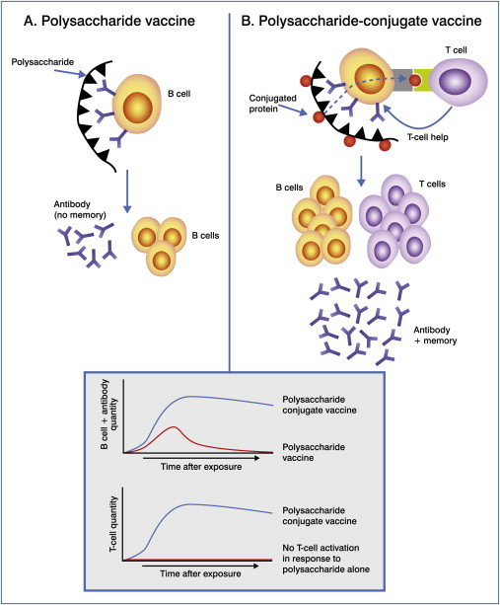

Slide 10
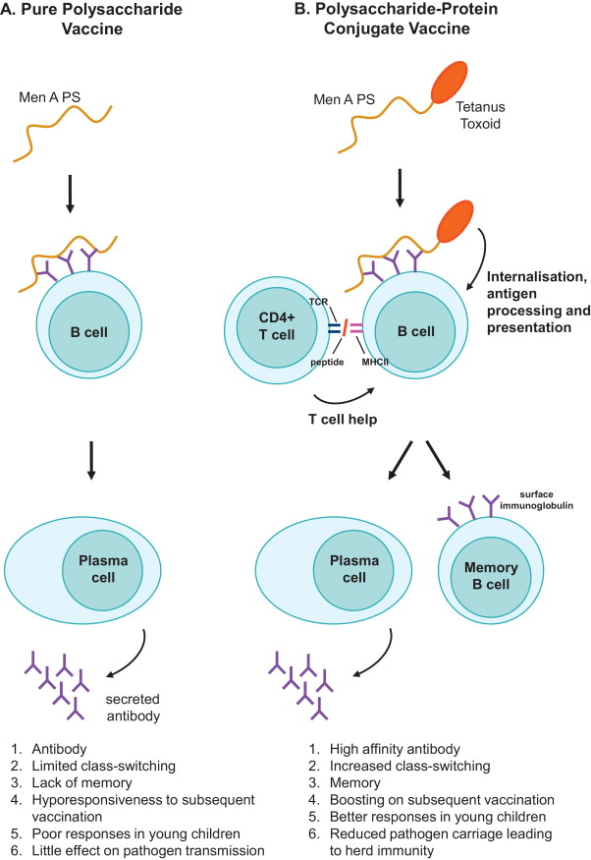

Slide 11
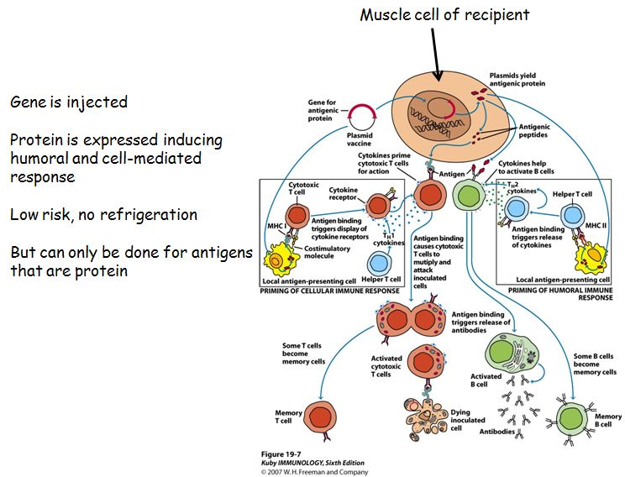
DNA Vaccines

Slide 12
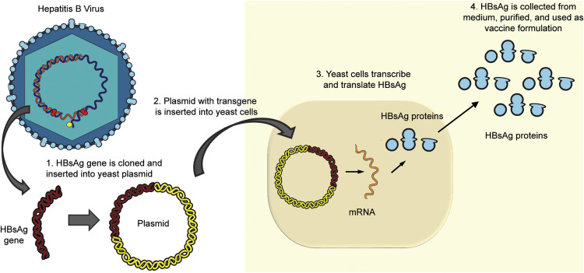
Recombinant Vaccines- The New Era

Slide 14
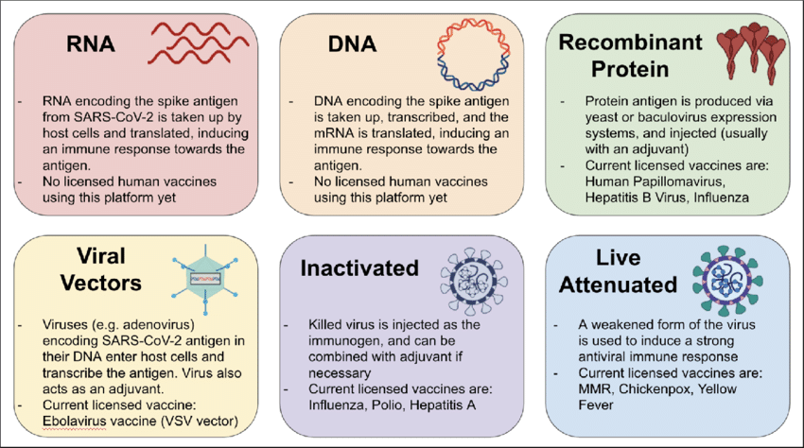

Slide 15
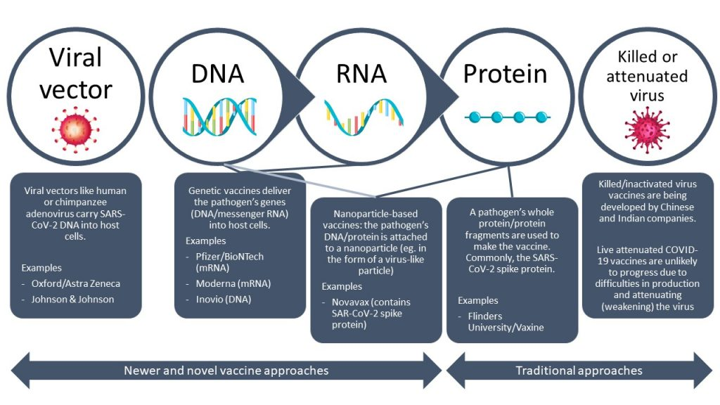
The SARS-Cov 2 Vaccines

Slide 16
