Slide 1
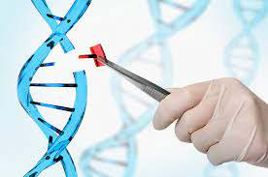
B.Sc. Part III
Paper II, Unit 1
Genetic Engineering (concept and recombinant DNA technology) and its application in agriculture & medical areas and energy production.

Slide 2
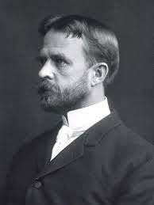
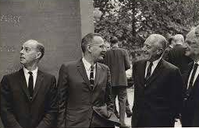
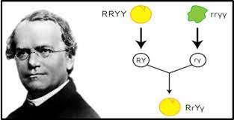
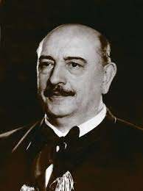

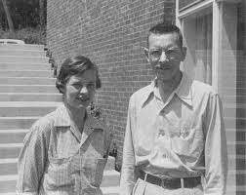
Genetic Engineering/ Biotechnology
It is a science that combines the use of technology in the field of biological sciences.
G. Mendel
18th Century
T.H. Morgan
Gene Mapping 1922
Avery, MacLeod, and McCarty
DNA as genetic material, 1944
Károly Ereky
Coined the term “Biotechnology”
Werner Arber
Restriction enzymes,
Late 1960s.
Nobel Prize, 1978
Hershey and Chase
Confirmed DNA as genetic material, 1944

Slide 3
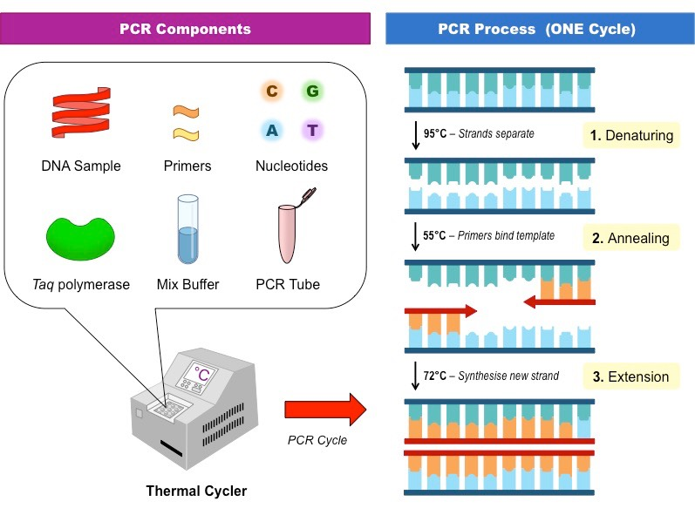
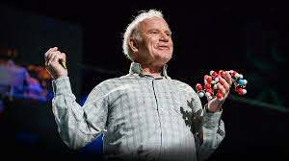
A brief History
1974 - First Publication on inserting foreign DNA in mice
September,1980 – First successful generation of transgenic mice
November, 1980 – First micro-injection of foreign DNA in fertilized eggs
5th July 1996 - Dolly, the first cloned sheep was born
14th February 2003 – Dolly died
Dr. Kary Mullis discovered Polymerase Chain Reaction (PCR) in 1985. A remarkable discovery that propelled the field of Biotechnology.
Nobel Prize in Chemistry 1993

Slide 4
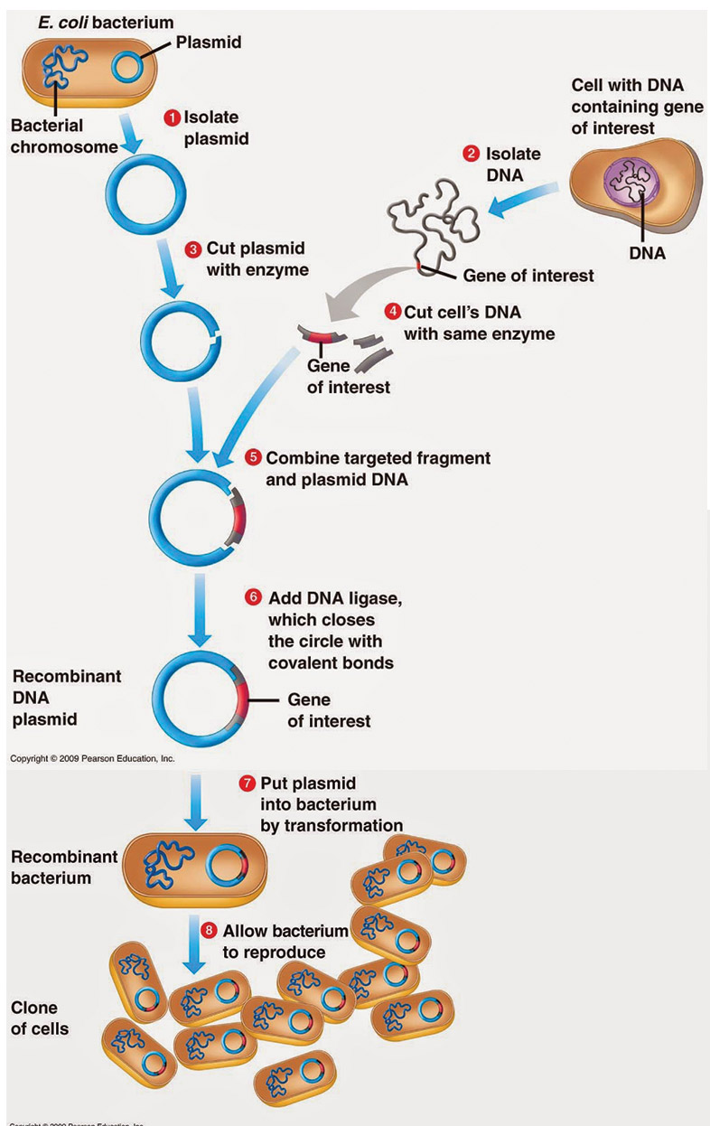
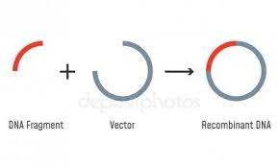
What is Gene Cloning ?
It is the generation of a new DNA molecule by combining genes from 2 different sets of DNA of 2 different organisms. Therefore, the new construct is a mixed form containing genes from both the organisms. It is called a Recombinant DNA or a Clone.

Slide 5
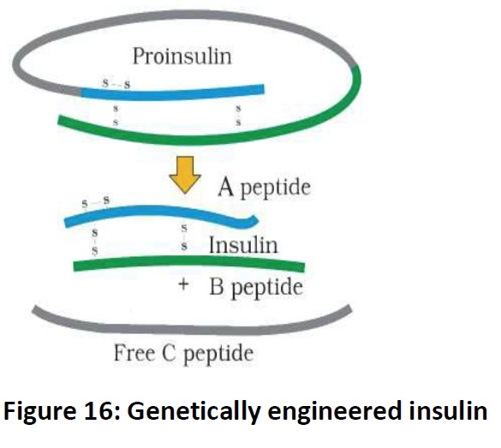

Slide 6
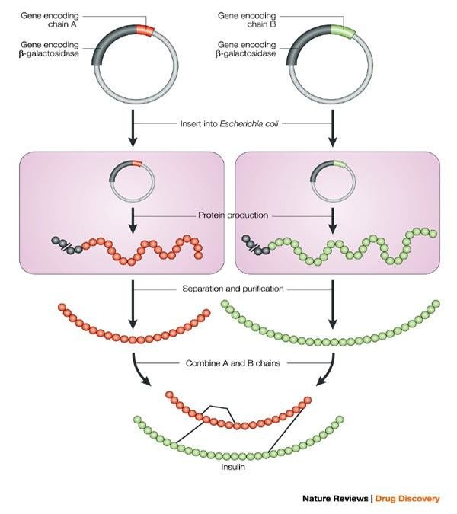

Slide 7
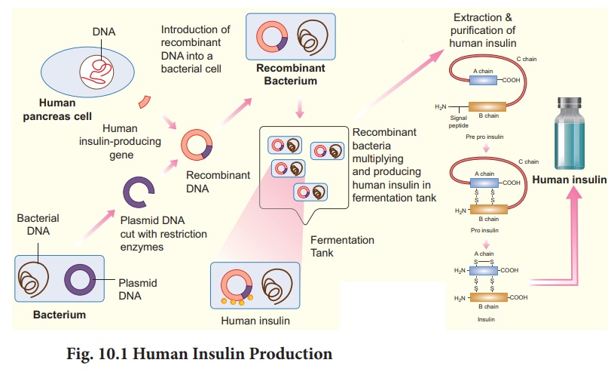

Slide 8
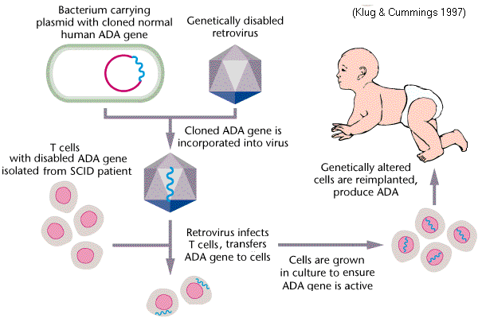
Adenine deaminase (ADA) Gene therapy for SCID patients

Slide 9
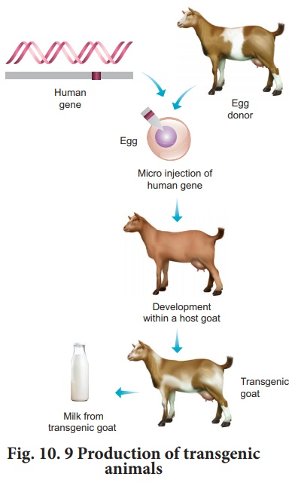
Transgenic Animals

Slide 10
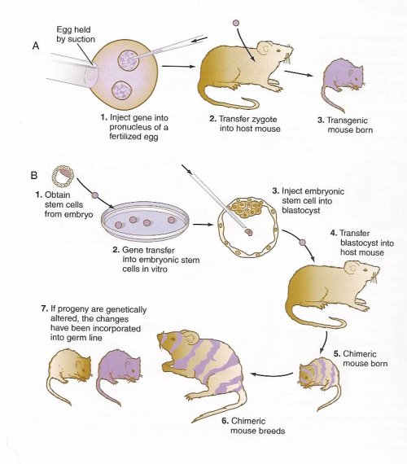

Slide 11
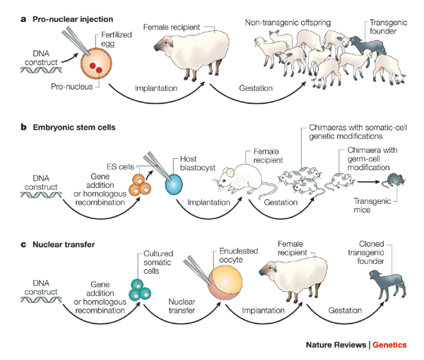

Slide 12
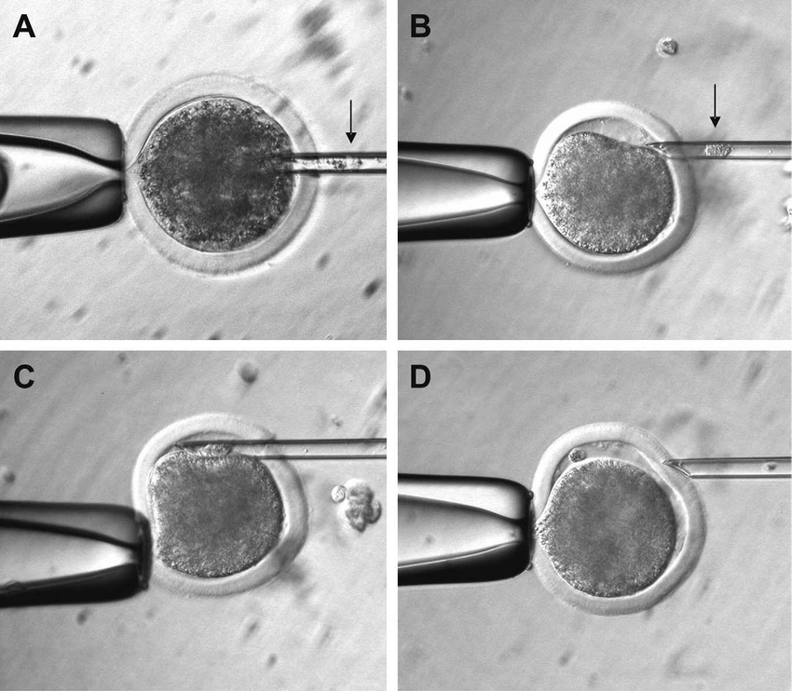

Slide 13
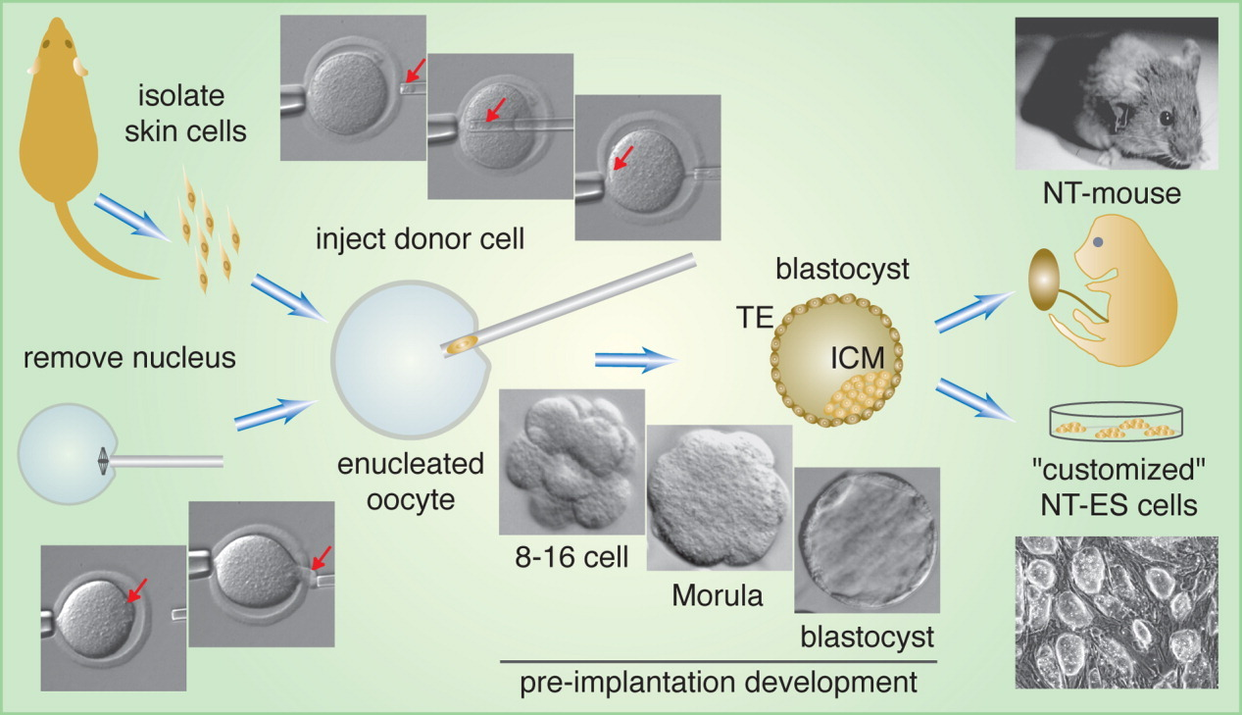
Somatic Nuclear Transfer (SNT)

Slide 14
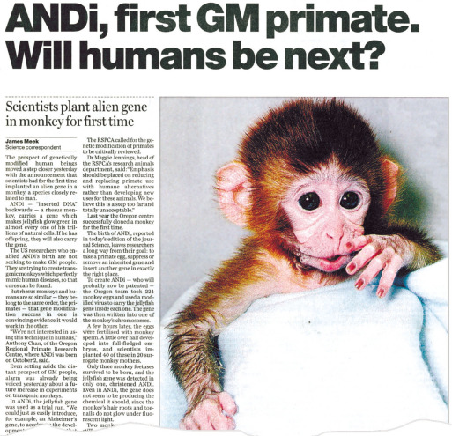
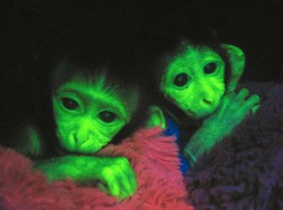
Glowing Monkey
Green Fluorescence Protein (GFP) inserted Transgenic monkey..

Slide 15
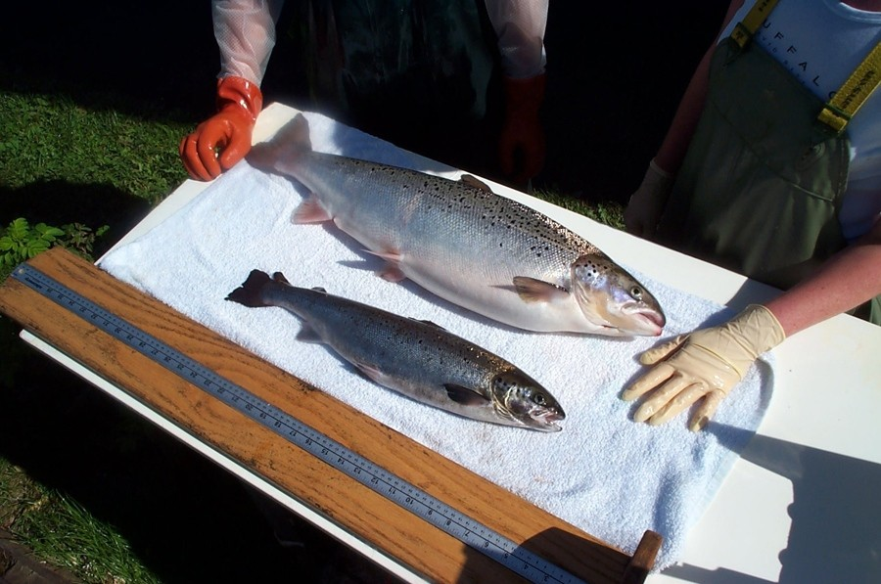
Transgenic vs. Normal Salmon

Slide 16
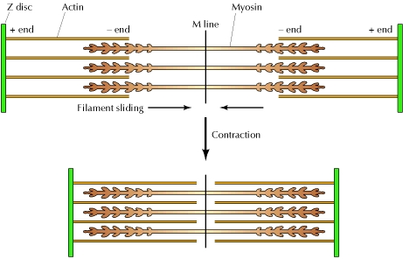

Slide 17
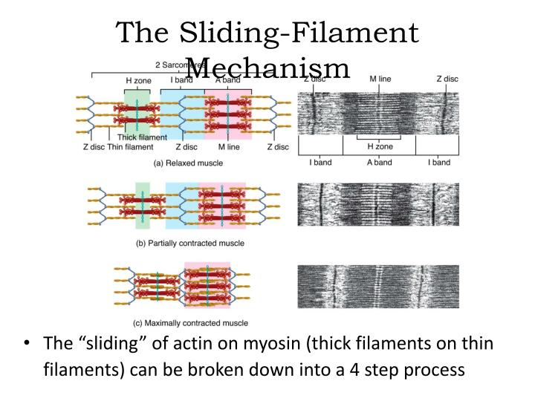

Slide 18
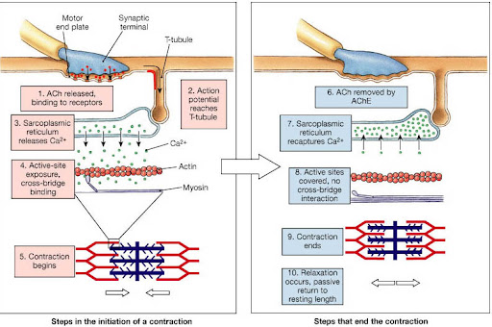

Slide 19
